Slide 1
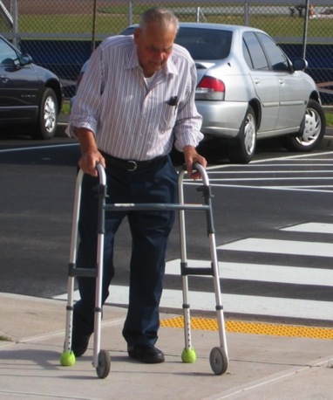
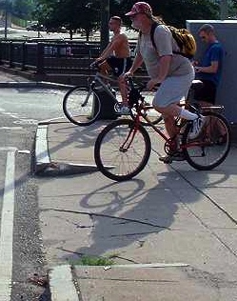
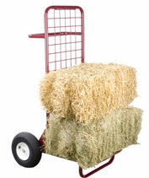
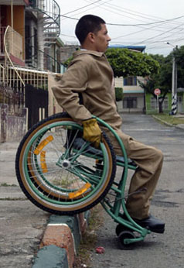
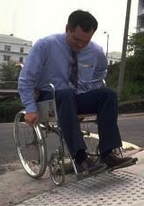
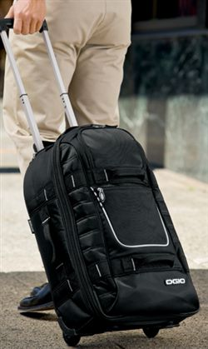
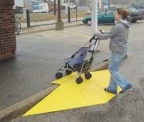
Curb cuts
Notes:
but we never would have helped all these people if we hadn’t looked closely at how to help this guy in the wheelchair.
* Ljungblad and Holmquist’s “pet snakes” paper/vocab:
Transfer scenarios: Grounding innovation with marginal practices, CHI’07.

