Slide 1
ECE560

Slide 2
Why ECE 560?
Randomness is (perhaps) inevitable due to:
Lack of knowledge
Inherent property of nature
Goal: develop foundational theory and techniques for:
Understanding complex phenomenon
Modeling complex systems, phenomenon
Prediction
Controlling uncertainty
Building engineering systems operating in uncertain environments
…

Slide 3
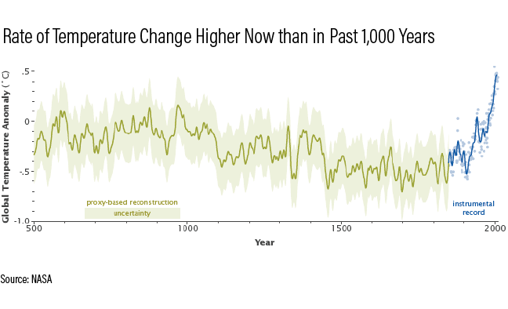

Slide 4
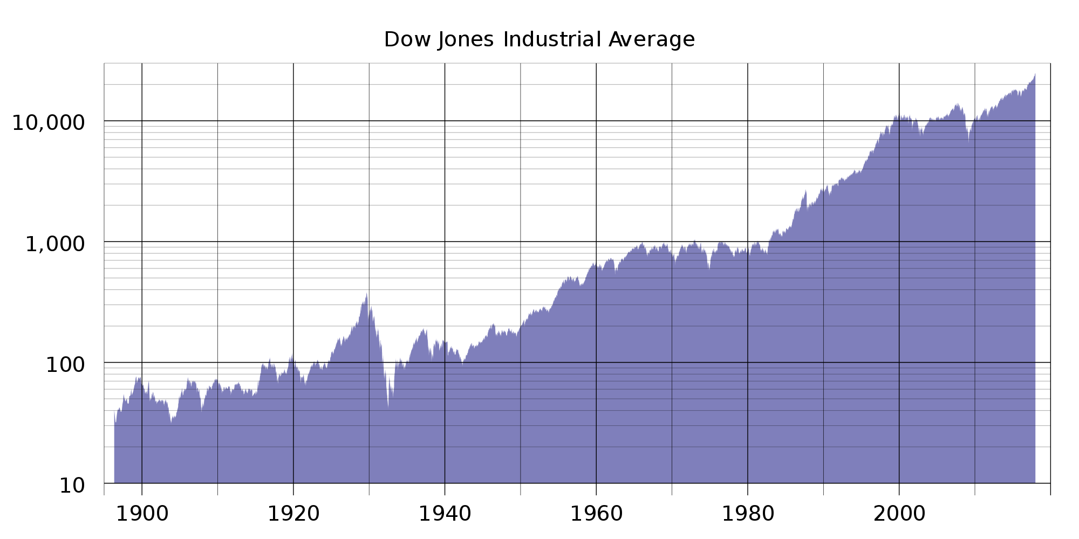

Slide 5
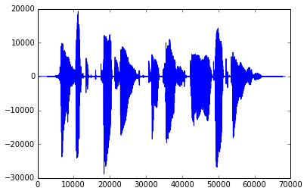

Slide 6
