Slide 1
The Interaction Between Record Matching and Data Repairing
Authors:
Wenfei Fan
Jianzhong Li
Shuai Ma
Nan Tang
Wenyuan Yu
Presenter:
Omeed Habibelahian

Slide 2
Background
Dirty data costs US businesses $600 billion each year
The market for data cleaning systems is growing 17% annually
Central pieces of data cleaning:
Record matching
Data repairing
Many data cleaning systems support both
Both processes often interact with each other
Nonetheless treated as separate and independent processes

Slide 3
Motivating Example
CFDs (𝜑) and MD (ψ):
𝜑₁: tran([AC = 131] → [city = ‘Edi’])
𝜑₂: tran([AC = 020] → [city = ‘Ldn’])
𝜑₃: tran([city, phn] → [St, AC, post])
𝜑₄: tran([FN = ‘Bob’] → [FN = ‘Robert’])
ψ: tran[LN, city, St, post] = card[LN, city, St, zip] ∧ tran[FN] ≈ card[FN] → tran[FN, phn] is changed to card[FN, tel]
Relations:
card(FN, LN, St, city, AC, zip, tel, dob, gd)
tran(FN, LN, St, city, AC, post, phn, gd, item, when, where)

Slide 4
Motivating Example
s₁ = card(FN = ‘Mark’, LN = ‘Smith’, St = ‘10 Oak St’, city = ‘Edi’, AC = 131, zip = ‘EH8 9LE’, tel = 3256778, dob = 10/10/1987, gd = ‘Male’)
s₂ = card(FN = ‘Robert’, LN = ‘Brady’, St = ‘5 Wren St’, city = ‘Ldn’, AC = 020, zip = ‘WC1H 9SE’, tel = 3887644, dob = 12/08/1975, gd = ‘Male’)
Bank suspects that both tuples are the same person → potential fraud
Get a repair t₃’ of t₃ with t₁’[city] = ‘Ldn’ (𝜑₂) and t₃’[FN] = ‘Robert’ (𝜑₄)
Match t₃’ to s₂ of D_{m}, to which ψ can be applied
Get a repair t₃’’ of t₃’ with t₃’’[phn] = s₂[tel]
Get a repair t₄’ of t₄ → 𝜑₃ since t₃’’ and t₄’ agree on city and phn
Fill t₄’[St] and fix t₄’[post] by taking those correct values from t₃’’
 | FN | LN | St | city | AC | post | phn | gd | item | when | where
t₁ | M. | Smith | 10 Oak St | Ldn | 131 | EH8 9LE | 9999999 | Male | watch | 11am 28/08/10 | UK
t₂ | Max | Smith | Po Box 25 | Edi | 131 | EH8 9AB | 3256778 | Male | DVD | 8pm 28/09/10 | IND
t₃ | Bob | Brady | 5 Wren St | Edi | 020 | WC1H 9SE | 3887834 | Male | iPhone | 6pm 06/11/09 | UK
t₄ | Robert | Brady | null | Ldn | 020 | WC1E 7HX | 3887644 | Male | necklace | 1pm 06/11/09 | US

Slide 5
Goals and Contributions
Goals:
Unify record matching and data repairing
Propose a data cleaning solution that stresses accuracy
Contributions:
Investigate a new problem: data cleaning problem
Propose uniform framework for data cleaning
Investigate fundamental problems associated with data cleaning via matching and repairing
Propose three-phase solution to solve the complexity brought on by these problems
Experimentally evaluate the quality and scalability of their proposed solutions

Slide 6
Data Cleaning Problem
Given a database D, master data D_{m}, and data quality rules consisting of CFDs Σ and matching rules Γ:
Goal: to find a repair D_{r} of D such that:
D_{r} satisfies the CFDs Σ
No more tuples in D_{r} can be matched to master tuples in D_{m} by rules of Γ
D_{r} minimally differs from D
Fix by unifying matching and repairing, and by leveraging master data
Use matching rules that are extensions of MDs by supporting neg. rules
E.g. a male and female may not refer to the same person
Notes:
Unlike record matching and data repairing, aims to fix data errors...

Slide 7
Positive MDs
For a tuple t in D and a tuple s in D_{m}, if for each j ∈ [1,k], t[A_{j}] and s[B_{j}] are similar, then for each i ∈ [1, h], t[E_{i}] is changed to s[F_{i}] (clean master data)
ψ: tran[LN, city, St, post] = card[LN, city, St, zip] ∧ tran[FN] ≈ card[FN] → tran[FN, phn] matches with card[FN, tel]
Instance D₁ of tran with tuple t₁’ with t₁’[city] = ‘Ldn’, all other A, t₁’[A] = t₁[A]
(D₁, D_{m}) does not satisfy ψ, since t₁’[FN, phn] does not match with s₁[FN, tel]
Correct t₁’[FN, phn] with s₁[FN, tel]

Slide 8
Negative MDs
For any tuple t in D and any tuple s in D_{m}, if t[A_{j}] ≠ s[B_{j}] for some j ∈ [1,k], then t and s may not be a match
ψ₁: tran[gd] ≠ card[gd] → there is some i ∈ [1,7] such that tran[A_{i}] does not match card[B_{i}]
(A_{i}, B_{i}) ranges over (FN, FN), (LN, LN), (St, St), (AC, AC), (city, city), (post, zip), and (phn, tel)
Says that a male and a female may not refer to the same person

Slide 9
Normalized CFDs and MDs
Normalized CFDs and MDs
A CFD or MD is called normalized if the RHS of the dependency has a length of 1,
CFD: RHS consists of a single attribute
MD: RHS consists of a single attribute pair
𝜑₁, 𝜑₂, and 𝜑₄ are normalized

Slide 10
UniClean
Input:
Dirty relation D
Master relation D_{m}
Set of cleaning rules derived from Θ = Σ ⋃ Γ, where Σ is a set of CFDs on R, and Γ is a set of MDs on (R, R_{m})
Thresholds η, δ ∈ [0, 1] set by the user for confidence and entropy
Output:
Repair D_{r} of D with a small cost such that D_{r} satisfies Σ and (D_{r}, D_{m}) satisfies Γ
Generates fixes by unifying matching and repairing, via cleaning rules
Distinguishes these fixes with three levels of accuracy
cost(D_{r}, D) =
Notes:
The three types of fixes are to stress accuracy

Slide 11
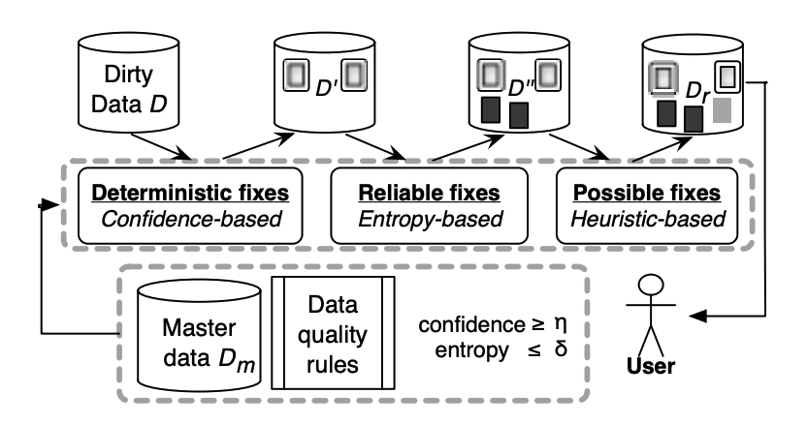
Framework

Slide 12
Confidence and Cost
The higher the confidence of the attribute t[A] is, the more “distant” v’ is from v, the more costly the change is
Smaller cost means that D_{r} is more accurate and closer to D
dis(v, v’)/max(|v|, |v’|) is used to measure similarity to ensure that longer strings with a 1-char difference are closer than shorter strings with a 1-char difference

Slide 13
Cleaning Rules
Tell us what attributes should be updated and what they should be changed to, and enable us to interleave matching and repairing operations
MDs:
Given MD 𝜓 = Λ_{j∈[1,k]}(R[A_{j}] ≈_{j} R_{m}[B_{j}]) → (R[E] matches with R_{m}[F])
Apply a master tuple s ∈ D_{m} to a tuple t ∈ D if t[A_{j}] ≈_{j} s[B_{j}] for each j ∈ [1,k]
Update on t:
t[E] = s[F]
t[C].cf = d for each C in E, where d is the minimum t[A_{j}].cf for all j ∈ [1,k] if ≈_{j} is ‘=’
This cleaning rule applies to both positive and negative MDs
Notes:
This rule corrects t[E] with clean master value s[F] and infers the new confidence of t[E] following fuzzy logic

Slide 14
Cleaning Rules
Constant CFDs:
Consider a CFD 𝜑_{c} = R(X → A, t_{p1}), where t_{p1}[A] is a constant
Rule applies to t if t[X] matches t_{p1}[X] but t[A] ≠ t_{p1}[A]
Update on t:
t[A] = t_{p1}[A]
t[A].cf = d, where d is the minimum t[A’].cf for all A’ in X
The rule corrects t[A] with constant in the CFD

Slide 15
Cleaning Rules
Variable CFDs:
Consider a CFD 𝜑_{v} = R(Y → B, t_{p2}), where t_{p2}[B] is a wildcard ‘_’
Apply a tuple t₂ in D to another tuple t₁ in D, where t₁[Y] = t₂[Y] ≍ t_{p2}[Y] but t₁[B] ≠ t₂[B]
Update on t:
t₁[B] = t₂[B]
t₁[B].cf = d, where d is the minimum t₁[B’].cf and t₂[B’].cd for all B’ in Y

Slide 16
Problems for Data Quality Rules
Consistency problem:
Whether there exists a nonempty instance D of R such that D satisfies Σ and (D, D_{m}) satisfies Γ
Determines whether the rules in Θ = Σ ⋃ Γ are dirty
For CFDs and MDs put together, NP-complete
Implication problem:
Determine, given D_{m}, Σ and another CFD or MD ξ, whether Σ satisfies ξ
Helps us find and remove redundant rules from Σ to remove performance
I.e. rules that are logical consequences of other rules
Θ implies another CFD or MD ξ if for any instance D of R, whenever D satisfies Σ and (D, D_{m}) satisfies Γ, then D ( or (D, D_{m})) satisfies ξ
coNP-complete

Slide 17
Problems for Data Quality Rules
Complexity bounds in the data cleaning problem:
Intractable to decide if there exists D_{r} with cost(D_{r}, D) below a predefined bound
Infeasible in practice to find a p-time approx. algorithm with performance guarantee
DCP is NP-complete
Unless P = NP, for any constant ϵ, there is no p-time ϵ-approximation algorithm for DCP
Termination problem: determine whether a rule-based process stops
Determinism problem: asks whether all terminating cleaning processes end with the same repair
E.g. 𝜑₁ = tran([AC] → [city], t_{p1} = (131 ∥ Edi)), 𝜑₅ = tran([post] → [city], t_{p5} = (EH8 9AB ∥ Ldn))
Instance D₁ containing tuple t₂ from earlier
t2: (‘Max’, ‘Smith’, ‘Po Box 25’, ‘Edi’, 131, ‘EH8 9AB’, 3256778 ‘Male’, ‘DVD, 800 INR’, ‘8pm 28/09/2010’, India)
Repair process with 𝜑₁ and 𝜑₅ will fail to terminate
Beyond reach to find efficient solutions for either problem

Slide 18
Important Notation
Θ = Σ ∪ Γ: a set Σ of CFDs and a set Γ of MDs
η = confidence threshold
δ₁ = update threshold
δ₂ = entropy threshold
⍴ = selection
π = projection
∆(ȳ) = the set (t | t is in D and t[Y] = ȳ) for each ȳ in π_{Y}(ρ_{Y matches tp[Y]}D) w.r.t. CFD (Y → B, t_{p})

Slide 19
Deterministic Fixes Based on Confidences
Identifies erroneous attributes t[A] to which there exists a unique fix, called a deterministic fix, when some attributes of t are accurate
Fixes based on confidence
Cleaning rule:
Update t[A] only if certain attributes of t have confidence above the threshold η
These fixes are accurate up to η

Slide 20
Deterministic Fixes on MDs
Given MD 𝜓 = Λ_{j∈[1,k]}(R[A_{j}] ≈_{j} R_{m}[B_{j}]) → (R[E] matches with R_{m}[F])
Suppose a cleaning rule 𝛾 applies a tuple s in D_{m} to a tuple t in D and generates a fix t[E] := s[F]
The fix is deterministic if:
t[A_{j}].cf >= η for all j ∈ [1,k]
t[E].cf < η
t[E] := s[F] only if all t[A_{j}]’s are asserted and t[E] is not yet asserted

Slide 21
Deterministic Fixes on Constant CFDs
Given constant CFD 𝜑_{c} = R(X → A, t_{p1})
Suppose 𝛾 applies to a tuple t in D and changes t[A] to t_{p1}[A] in 𝜑_{c}
The fix is deterministic if:
t[A_{i}].cf >= η for all A_{i} ∈ X
t[A].cf < η

Slide 22
Deterministic Fixes on Variable CFDs
Given constant CFD 𝜑_{v} = (Y → B, t_{p})
For each ȳ in 𝜋_{Y}(⍴_{Y matches tp[Y]}D), Δ(ȳ) = {t | t ∈ D, t[Y] = ȳ}
Suppose 𝛾 applies a tuple t₂ in Δ(ȳ) to another t₁ in Δ(ȳ) for some ȳ, and changes t₁[B] to t₂[B]
The fix is deterministic if:
For all B_{i} in Y, t₁[B_{i}].cf >= η and t₂[B_{i}].cf >= η
t₂ is the only tuple in Δ(ȳ) with t₂[B].cf >= η
Which means t₁[B].cf < η

Slide 23
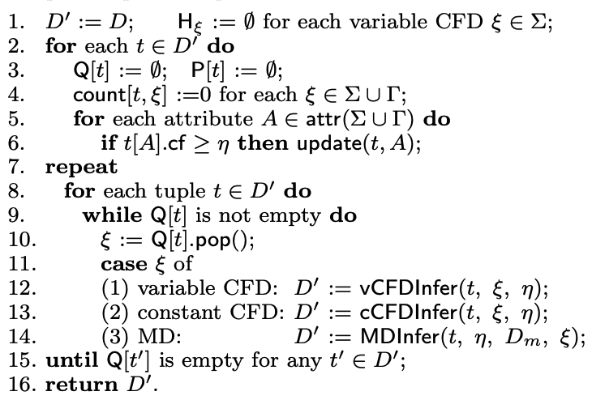
Deterministic Fix Algorithm: cRepair
Update:
Given a new deterministic fix for t[A], propagate the change to find other deterministic fixes with t[A]
For each variable CFD ξ, if A is in LHS(ξ), count[t, ξ] is incremented
If all attributes in LHS(ξ) are asserted, insert ξ into the queue
For a variable CFD ξ’ in P[t], if RHS(ξ’) is A and the hash value of ξ’ is nil, t[A] makes it possible for tuples in the list to have a deterministic fix, so move ξ’ from P[t] to the queue

Slide 24
Deterministic Fix Algorithm: cRepair
vCFDInfer:
Find a deterministic fix for t by applying ξ if it exists
If t and the pattern tuple t_{(p, ξ)} match on their LHS(ξ) attributes:
If t[RHS(ξ)] >= η and no B-attr in the hash list of ξ is asserted, take t[RHS(ξ)] as the B-value in the set and updates
If t[RHS(ξ)] < η but there is an asserted B-attr val in the hash list, do deterministic fix t[RHS(ξ)] = val and update
If t[RHS(ξ)] < η and no asserted B-attr val in hash list, no deterministic fix; add t to hash list and P[t] for later checking
cCFDInfer and MDInfer
Find deterministic fixes by applying the rules derived from ξ
Propagate changes by invoking update(t, RHS(ξ))

Slide 25
cRepair: Example
Consider D_{m} and D from the beginning
Θ consists of rules ξ₁, ξ₂, and ξ₃ based on 𝜑₁, 𝜑₃, and ψ
η = 0.8
Find deterministic fixes for t₁ and t₂ w.r.t. η
After lines 1-6:
H_{ξ2} = Ø
Q[t₁] = {ξ₁}
Q[t₂] = {ξ₂}
P[t₁] = P[t₂] = Ø
count[t₁, ξ₁] = 1, count[t₁, ξ₂] = 0, count[t₁, ξ₃] = 3, count[t₂, ξ₁] = 0, count[t₂, ξ₂] = 0, count[t₂, ξ₃] = 2
After ξ₂ in Q[t₂] is checked:
Q[t₂] = Ø
P[t₂] = ξ₂
H_{ξ2}(t₂[city, phn]) = ({t₂}, nil)

Slide 26
cRepair: Example
After ξ₁ in Q[t₁] is applied:
Q[t₁] = {ξ₃}
count[t₁, ξ₂] = 1
count[t₁, ξ₃] = 4
t₁[city] := ‘Edi’
t₁[city].cf = 0.8
When ξ₃ in Q[t₁] is used:
t₁[phn] := s₁[tel]
t₁[phn].cf = 0.8
Q[t₁] = ξ₂
count[t₁, ξ₂] = 2
When ξ₂ in Q[t₁] is used:
t₂[St] = t₁[St] = ‘10 Oak St’
t₂[St].cf = 0.8
Q[t₁] = Ø
P[t₂] = Ø
Terminates since Q[t₁] and Q[t₂] are both empty

Slide 27
Reliable Fixes Based on Entropy
For attributes with low or unavailable confidence, we correct them based on the relative certainty of the data, measured by entropy
Cleaning rule γ:
Update t[A] only if the entropy of γ for certain attributes of t is below the threshold δ
Fixed based on entropy are accurate to a certain degree and marked as reliable fixes

Slide 28
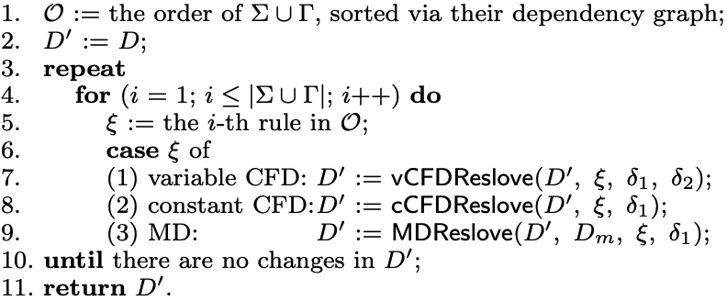
Reliable Fix Algorithm: eRepair
Sort cleaning rules based on dependency graph G = (V, E)
Each rule of Σ ∪ Γ is a node in V
Edge from ξ₁ to ξ₂ if ξ₂ can applied after the application ξ₁
Edge (u, v) means u should be applied before v
Find SCCs in G, convert G to DAG
Find topological order on nodes
Sort SCC on ratio of out-degree to in-degree, in decreasing order
Higher ratio = more effect on other nodes

Slide 29
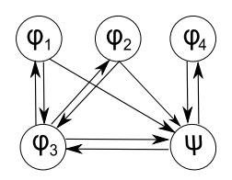
Dependency Graph Example
This graph G is an SCC
Ratios of out-degree to in-degree are:
𝜑₁: 2/1
𝜑₂: 2/1
𝜑₃: 1/1
𝜑₄: 3/3
ψ: 2/4
Therefore, order O is 𝜑₁ > 𝜑₂ > 𝜑₃ > 𝜑₄ > ψ
Nodes with the same ratio are sorted randomly

Slide 30
Reliable Fix Algorithm: eRepair
vCFDResolve:
Applies cleaning rule derived from a variable CFD ξ = R(Y → B, t_{p})
For each set ∆(ȳ) with ȳ in π_{Y} (⍴_{Y≍tp[Y]}D), if the entropy of ξ for Y = ȳ < the entropy threshold δ₂, pick the value b ∈ π_{B}(∆(ȳ)) that has max. cnt_{Y B}(ȳ, b)
For each tuple t in ∆(ȳ), if t[B] has been changed less than δ₁ times, t[B] := b

Slide 31
Reliable Fix Algorithm: eRepair
cCFDResolve:
Applies cleaning rule derived from CFD ξ = R(X → A, t_{p1})
For each tuple t in D, if t[X] ≍ t_{p1}[X], if t[A] ≠ t_{p1}[A], and if t[A] has been changed less than δ₁ times, then update t[A] to t_{p1}[A]

Slide 32
Reliable Fix Algorithm: eRepair
MDResolve:
Applies cleaning rule derived from MD ξ = Λ_{j∈[1,k]}(R[A_{j}] ≈_{j} R_{m}[B_{j}]) → (R[E] matches with R_{m}[F])
For each tuple t in D, if there exists some s in D_{m} such that t[A_{j}] ≈_{j} s[B_{j}] for j ∈ [1, k], t[E] ≠ s[F], and t[E] has been changed less than δ₁ times
t[E] := s[F]
Fixes by cRepair not affected

Slide 33
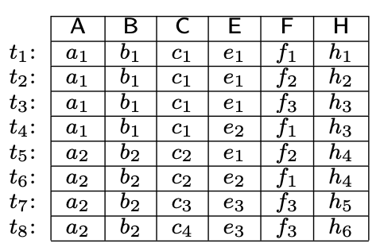
eRepair: Example
Instance of schema R(ABCEFH) shown here
CFD ϕ = R(ABC → E, t_{p1}); t_{p1} only wildcards
ϕ is an FD
H(ϕ | ABC = (a₁, b₁, c₁)) ≈ 0.8
H(ϕ | ABC = (a₂, b₂ c₂)) = 1
H(ϕ | ABC = (a₂, b₂, c₃)) = 0
H(ϕ | ABC = (a₂, b₂, c₄)) = 0
∆(ABC = (a₂, b₂, c₃)) and ∆(ABC = (a₂, b₂, c₄)) do not violate ϕ
Fix based on H(ϕ | ABC = (a₁, b₁, c₁)) is fairly accurate, but not H(ϕ | ABC = (a₂, b₂ c₂))
eRepair changes t₄[E] to e₁, marks as reliable

Slide 34
Possible Fixes
For errors that have not yet been fixed
Use heuristic methods to generate fixes, called possible fixes
The heuristic method always finds a repair D_{r} of D such that D_{r} satisfies Σ and (D_{r}, D_{m}) satisfies Γ
Does not touch deterministic fixes produced earlier
After this whole process, fixes are marked with distinct signs to indicate deterministic, reliable, and possible fixes

Slide 35
Experimental Study
Two real-world data sets:
HOSP data from US Dept of HHS → 100k records with 19 attributes
DBLP data from DBLP Bibliography → 400k tuples, each with 12 attributes
Master data carefully selected from same sources for correctness and consistency w.r.t. the designed rules
Dirty datasets produced by introducing noise, controlled by 4 parameters:
|D|: data size
noi%: noise rate → ratio of # erroneous attrs to total attrs in D
dup%: duplicate rate → % of tuples in D that can find a match in D_{m}
asr%: asserted rate → default value = 40%
Notes:
HOSP: Designed 23 CFDs and 3 MDs
DBLP: Designed 7 CFDs and 2 MDs

Slide 36
Experimental Study
Algorithms
All algorithms implemented in Python
cRepair, eRepair, hRepair in UniClean
hRepair is the heuristic-based algorithm for possible fixes in UniClean
SortN: sorted neighborhood method; for record matching based on MDs only
quaid: heuristic repairing algorithm; based on CFDs only
Uni refers to cleaning based on both CFDs and MDs
Uni(CFD) denotes cleaning using CFDs (repairing) only
Edit distance used for similarity test

Slide 37
Experimental Study
Metrics: precision, recall, F-measure
Precision: ratio of true matches correctly found to all duplicates found
Recall: ratio of true matches correctly found to all matches between a dataset and master data
F-measure = 2 * (precision * recall) / (precision + recall)
In all experiments, η = 1.0, δ = 0.8; dirty and master data have 60k tuples

Slide 38
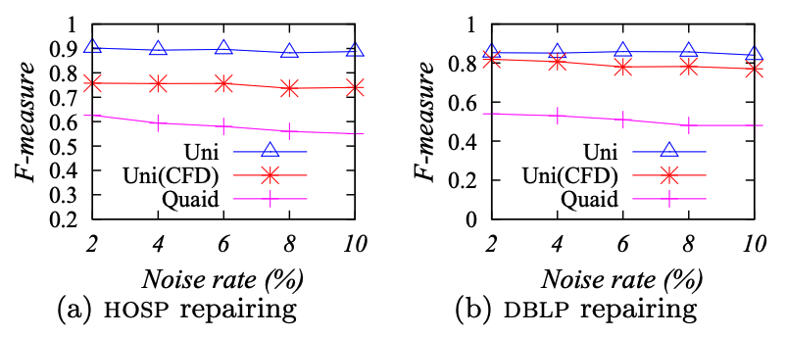
Exp-1: Matching Helps Repairing
dup% set to 40% (CFDs only)
Uni outperforms Uni(CFD) and quaid by up to 15% and 30%
Uni is less sensitive to noi%
Uni(CFD) also outperforms quaid
Notes:
Deterministic and reliable fixes are more accurate than possible fixes

Slide 39
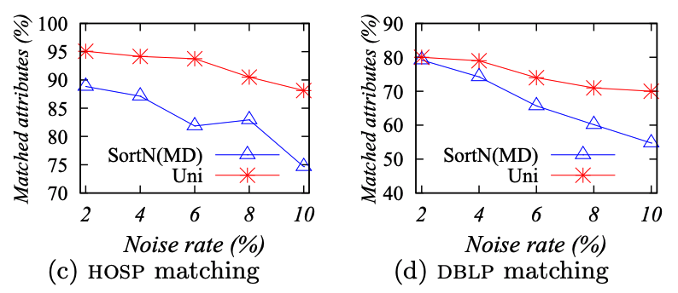
Exp-2: Repairing Helps Matching
Same settings and dup% as Exp-1
Uni outperforms SortN by up to 15%
Uni is less sensitive to noi%
Repairing does indeed help with matching

Slide 40
Exp-3: Accuracy of Det. and Reliable Fixes
Same dup% as Exp-1 and Exp-2
Deterministic fixes have the highest precision but have low recall
Fixes by Uni have the lowest precision but the highest recall
Notes:
cRepair denotes only deterministic fixes generated in the first phase of UniClean
cRepair + eRepair denotes deterministic and reliable fixes generated in the first two phases of UniClean

Slide 41
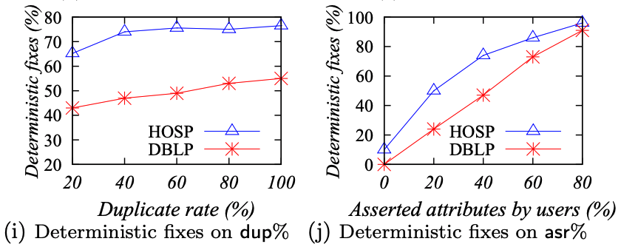
Exp-4: Impact of dup% and asr% on Det. Fixes
(i): asr% set to 40%, (j): dup% set to 40%
The larger dup% is, the more deterministic fixes are found
The number of deterministic fixes found by cRepair highly depends on asr%
Cleaning rules are only applied to asserted attributes to find these fixes

Slide 42
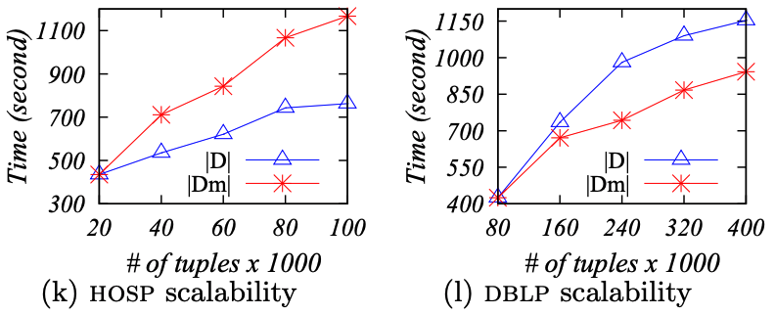
Exp-5: Scalability
noi% set to 6%, dup% set to 40%
Uni scales reasonably well with both, and does so much better than quaid
quaid took >10 hours to scale with |D| = 80k; Uni took about 11 min
Verify effectiveness of indexing structures and optimization techniques developed for Uni
Notes:
In one curve, |D_{m}| is fixed to 60k, and in the other, |D| is fixes to 60k

