Slide 1
Answering Queries Using Views: A Survey
Alon Y. Levy

Slide 2
Motivation
Rewriting queries using views is important because of its relevance in the following areas:
Query optimization
Maintenance of physical data independence
Data integration
Data warehouse design

Slide 3
Query Optimization
A view can be used to speed up the computation of a query.
Prof(name, area)
Teaches(prof, course, quarter)
Registered(student, course, quarter)
Course(title, number)
select student
from Teaches, Prof, Registered, Course
where Prof.name=Teaches.prof and
Teaches.course=Registered.course and
Teaches.quarter=Registered.quarter and Registered.course=Course.title and
Course.number >= 500 and Prof.area="DB".

Slide 4
Query Optimization
Materialized View
create view Graduate as
select student, course, number, quarter
from Registered, Course
where Registered.course=Course.title and Course.number>= 400.

Slide 5
Query Optimization
We exploit the materialized view in order to eliminate joins.
There may be multiple combinations.
select student
from Teaches, Prof, Graduate
where Prof.name=Teaches.prof and
Teaches.course=Graduate.course and Teaches.quarter=Graduate.quarter and
Graduate.number >= 500 and Prof.area="DB".

Slide 6
Query Optimization
Our aim here is not to find an equivalent rewriting.
We have to find all the rewritings and evaluate their costs in order to select the cheapest plan.
In some cases views may not help due to loss of indexes.

Slide 7
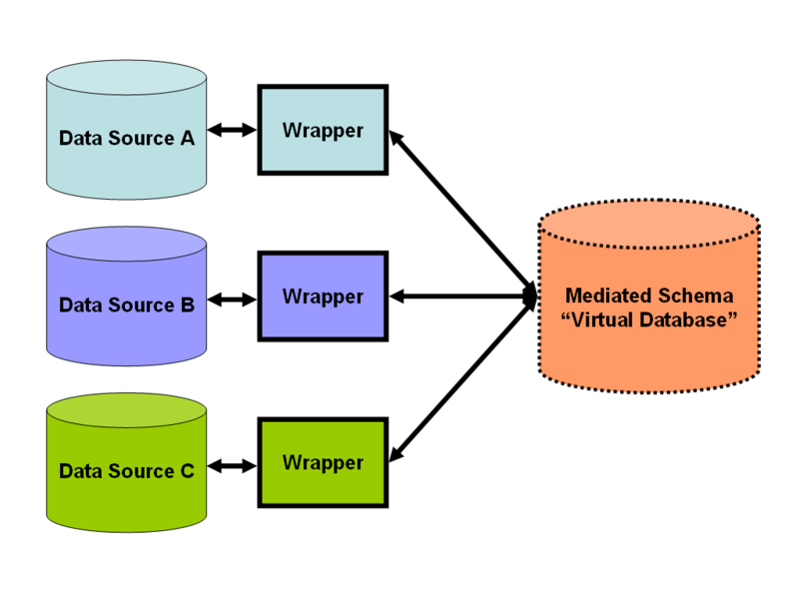
Data Integration

Slide 8
Data Integration
Mediated Schema: is a set of “virtual” relations which allows information to be retrieved directly from the original databases.
Wrappers: are custom-built programs that transform data from the source native format to something acceptable to the mediator.
Wrappers have to change if source interface changes
Notes:
Mediated schema is not stored anywhere and it is manually created for a particular data integration system

Slide 9
Data Integration
The data integration system: Translates queries formulated on the mediated schema into ones that refer directly to the source schema.
Some Challenges
Designing a single mediated schema: Data sources might have different schemas, and might export data in different formats
Incomplete data sources: Data at any source might be partial, overlap with others, or even conflict

Slide 10
Data Integration
A listing of all the courses titled “Database Systems” taught in the country and their instructors
Data Source 1:
DB-courses
create view DB-courses as
select Course.title, Teaches.prof, Course.number, Course.univ
from Teaches, Course
where Teaches.course number=Course.number and Teaches.univ=Course.univ and Course.title="Database Systems".
A listing of all the Ph.D level courses being taught at UW
Data Source 2:
UW-phd-courses
create view UW-phd-courses as
select Course.title, Teaches.prof, Course.number, Course.univ
from Teaches, Course
where Teaches.course-number=Course.number and
Course.univ="UW" and Teaches.univ="UW" and Course.number>=500.

Slide 11
Data Integration
A listing of who teaches Database courses at UW
Complete answer at source DB-Courses
select prof
from DB-courses
where univ="UW".
A listing of all the graduate-level courses (i.e., number 400 and above) being offered at UW
Incomplete answer at both DB-Courses and Duke-Grad
select title, number
from DB-courses
where univ="UW" and number>=400
UNION
select title, number
from UW-phd-courses.
Notes:
Whereas in the contexts of query optimization and maintaining physical data independence the focus is on finding a query expression that is equivalent to the original query, here we attempt to find a query expression that provides the maximal answers from
the views.

Slide 12
Data Integration
Mappings between the mediated schema and the schema of original sources, and transforming a query into specialized queries to match the schema of the original databases.
Such mappings can be specified in 2 ways :
Global-As- View (GAV): as a mapping from entities in the mediated schema to entities in the original sources
Local-As- View (LAV): a mapping from entities in the original sources to the mediated schema

Slide 13
Global-As-View (GAV)
Mediated Schema: Movie(title, dir, year, genre)
Data Sources and local schemas:
S1[Movie(title,dir,year,genre)]
S2[Director(title,dir), Movie(title,year,genre)]
Create View Movie As
Select * from S1.Movie
Union
Select * from S2.Director, S2.Movie
where S2.Director.title = S2.Movie.title

Slide 14
Global-As-View (GAV)
The main advantage of GAV is its conceptual and algorithmic simplicity.
The global schema is simply defined using views over the data sources and specifies how to obtain tuples of the global relation from tuples in the sources.
Rules that map a mediator query to source queries.
Like regular views, what we see through the mediator is a subset of the available world.

Slide 15
Local-As-View (LAV)
Mediated Schema: Movie(title, dir, year, genre)
Data Sources and local schemas:
S1[Movie(title,dir,year,genre)]
S2[Director(title,dir), Movie(title,year,genre)]
Create Source S1.Movie As
Select * from Movie
Create Source S2.Movie As
Select title, year, genre from Movie

Slide 16
Local-As-View (LAV)
The local relations are defined as views over global relations.
Defines the global schema in such a way that individual definitions do not change when data sources join or leave the integration system.
Every source provides expressions on how it can generate pieces of the global schema.
Mediator can combine these expressions to find all possible ways to answer a query.

Slide 17
Comparison of GAV and LAV
GAV:
Quality depends on how well we have compiled the sources into the global schema through the mapping
Whenever a source changes or a new one is added, the global schema needs to be reconsidered
Query processing can be based on some sort of unfolding (query answering looks easier – without constraints)
Better for static static, centralized systems.

Slide 18
Comparison of GAV and LAV
LAV:
Quality depends on how well we have characterized the sources
Query processing needs reasoning (query answering complex)
Better for dynamic, distributed systems.
Requires more sophisticated inferences to resolve a query on the mediated schema, but makes it easier to add new data sources to a (stable) mediated schema.

Slide 19
Queries and Views: Conjunctive Queries
Conjunctive query - a query that is formed only of conjunctions of predicates.
Joins are expressed with multiple occurrences of the same variable
Q(X,T) :-
Interview(X,D,Y,H,F), EmployeePerf(E,Y,T,W,Z), W < 2.5.
select recruiter, candidate
from Interview, EmployeePerf
where recruiter=name AND grade < 2.5

Slide 20
Query Containment and Equivalence
For Q₁ is contained Q₂ For any database D the set of tuples computed for Q₁ is a subset of those computed for Q_{2.} It is denoted as Q₁ ⊆ Q₂ .
Equivalence of queries: Q1≡Q2 if they return the same answers for all databases. This is the same as Q₁ ⊆ Q₂ and Q₂ ⊆ Q₁

Slide 21
Rewriting of Queries using Views: Equivalent rewriting
Input: Query Q
View definitions: V₁,…,V_{n}
A rewriting: a query Q’ that refers only to the views and interpreted predicates.
An equivalent rewriting of Q using V₁,…,V_{n}:
1. Q’ only refers to the views V₁,…,V_{n}
2. a rewriting Q’, such that Q’ ≡ Q.

Slide 22
Rewriting of Queries using Views: Maximally-contained rewriting
Input: Query Q
Rewriting query language L
View definitions: V₁,…,V_{n}
Q’ is a maximally-contained rewriting of Q given V₁,…,V_{n} and L if:
1. Q’ ∈ L,
2. Q’ ⊆ Q, and
3. there is no Q’’ in L such that Q’’ ⊆ Q and Q’⊂ Q’’

Slide 23
Rewriting of Queries using Views: Certain Answers
Maximally-contained rewriting depends on the expressive power of the query language
What is the best we can do (regardless of the query language)?
Find all certain answers of a query using views
Tuple t is a certain answer to Q if t is in the result of Q for any database instance that is “consistent” with the given view contents.

Slide 24
Rewriting of Queries using Views: Closed- vs. open-world assumption
Closed-world assumption: Views contain complete answers
Open-world assumption: Views may contain incomplete answers
Example: R(A, B), V₁ = π_{A} R, V₂ = π_{B} R, Q = R
Suppose V₁ contains a single tuple (a), and V₂ contains a single tuple (b)
Under closed-world assumption, (a, b) is a certain answer to Q
Under open-world assumption, (a, b) is not certain

Slide 25
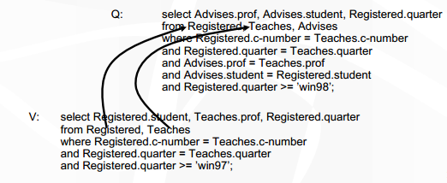
When is a view usable for a query
Each occurrence of a table in V must be matched with an occurrence of the same table in Q.
Advises(prof, student)
Teaches(prof, c-number, quarter)
Registered(student, c-number, quarter)

Slide 26
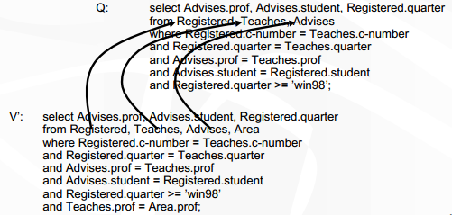
When is a view usable for a query
Intuition: If a table is joined in V but not in Q, then V is unusable because the additional join may filter out some V tuples that could contribute to Q

Slide 27
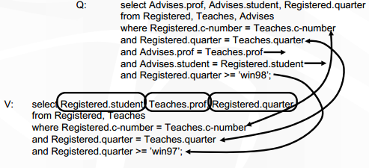
When is a view usable for a query
V must either apply the join and selection predicates in Q, or apply a logically weaker predicate (or not applying it at all) and preserve the attributes on which the predicates still need to be applied (unless these attributes can be recovered somehow)

Slide 28
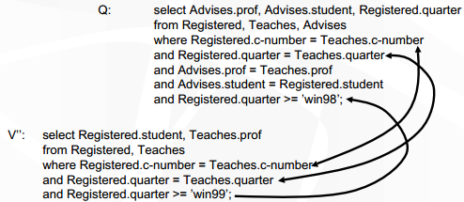
When is a view usable for a query
Intuition: If a table is joined in V but not in Q, then V is unusable because the additional join may filter out some V tuples that could contribute to Q

Slide 29
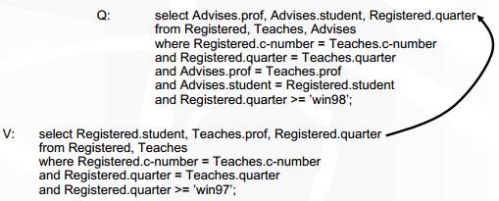
When is a view usable for a query
V must not project out attributes that are selected by Q (unless they can be recovered somehow)

Slide 30
Answering Queries using Data Integration
So far we focused on extending query optimizers to accommodate the use of views.
They were designed to handle cases in which the number of views is relatively small.
The context of data integration requires that we consider a large number of views.

Slide 31
The Bucket Algorithm
Q(S,D) :- Enrolled(S,D), Registered(S,C,Y), Course(C,N), N>=300, Y>=1995.
Views
V1(student,number,year) :- Registered(student,course,year), Course(course,number),
number>=500, year>=1992.
V2(student,dept,course) :- Registered(student,course,year), Enrolled(student,dept)
V3(student,course) :- Registered(student,course,year), year<= 1990.
V4(student,course,number) :- Registered(student,course,year), Course(course,number), Enrolled(student,dept), number<=100

Slide 32
The Bucket Algorithm
Step 1: For each query subgoal, put the relevant sources into a bucket
V1(S,N,Y) :- Registered(S,C,Y), Course(C,N), N>=500, Y>=1992.
V2(S,D,C) :- Registered(S,C,Y), Enrolled(S,D)
V3(S,C) :- Registered(S,C,Y), Y<= 1990.
V4(S,C,N) :- Registered(S,C,Y), Course(C,N),Enrolled(S,D), N<=100
Q(S,D) :- Enrolled(S,D), Registered(S,C,Y), Course(C,N), N>=300, Y>=1995.
{ S student, D dept }
Buckets
Enrolled(S,D) | Registered(S,C,Y) | Course(C,N)
V2(S,D,C')
V4(S,C',N')
Enrolled(S,D) Registered(S,C,Y) Course(C,N)
V2(S,D,C') V1(S,N',Y) V1(S',N,Y')
V4(S,C',N') V2(S,D',C)
V4(S,C,N')

Slide 33
The Bucket Algorithm
Step 1: For each query subgoal, put the relevant sources into a bucket
V1(S,N,Y) :- Registered(S,C,Y), Course(C,N), N>=500, Y>=1992.
V2(S,D,C) :- Registered(S,C,Y), Enrolled(S,D)
V3(S,C) :- Registered(S,C,Y), Y<= 1990.
V4(S,C,N) :- Registered(S,C,Y), Course(C,N),Enrolled(S,D), N<=100
Q(S,D) :- Enrolled(S,D), Registered(S,C,Y), Course(C,N), N>=300, Y>=1995.
{ S student, C course, Y year }
Buckets
Enrolled(S,D) | Registered(S,C,Y) | Course(C,N)
V2(S,D,C') | V1(S,N',Y)
V4(S,C',N') | V2(S,D',C)
 | V4(S,C,N')
Notes:
The view V3 is not included in the bucket of Registered(S,C,Y) because after applying the
unification mapping, the predicates Y>= 1995 and year<=1990 are mutually inconsistent.
However, the unification mapping does not include the variable N in its
domain, and therefore the variable N is not mapped to the variable number in V4, and the
contradiction between the predicates does not arise.

Slide 34
The Bucket Algorithm
Step 1: For each query subgoal, put the relevant sources into a bucket
V1(S,N,Y) :- Registered(S,C,Y), Course(C,N), N>=500, Y>=1992.
V2(S,D,C) :- Registered(S,C,Y), Enrolled(S,D)
V3(S,C) :- Registered(S,C,Y), Y<= 1990.
V4(S,C,N) :- Registered(S,C,Y), Course(C,N),Enrolled(S,D), N<=100
Q(S,D) :- Enrolled(S,D), Registered(S,C,Y), Course(C,N), N>=300, Y>=1995.
{ C course, N number }
Buckets
Enrolled(S,D) | Registered(S,C,Y) | Course(C,N)
V2(S,D,C') | V1(S,N',Y) | V1(S',N,Y')
V4(S,C',N') | V2(S,D',C)
 | V4(S,C,N')

Slide 35
The Bucket Algorithm
Step 2: Combine candidates from buckets and check containment.
V1(S,N,Y) :- Registered(S,C,Y), Course(C,N), N>=500, Y>=1992.
V2(S,D,C) :- Registered(S,C,Y), Enrolled(S,D)
V3(S,C) :- Registered(S,C,Y), Y<= 1990.
V4(S,C,N) :- Registered(S,C,Y), Course(C,N),Enrolled(S,D), N<=100
Q(S,D) :- Enrolled(S,D), Registered(S,C,Y), Course(C,N), N>=300, Y>=1995.
Q’(S,D) :- V2(S,D,C’), V1(S,N’,Y), V1(S’,N,Y’).
Buckets
Enrolled(S,D) | Registered(S,C,Y) | Course(C,N)
V2(S,D,C') | V1(S,N',Y) | V1(S',N,Y')
V4(S,C',N') | V2(S,D',C)
 | V4(S,C,N')

Slide 36
The Bucket Algorithm
Step 2: Combine candidates from buckets and check containment.
V1(S,N,Y) :- Registered(S,C,Y), Course(C,N), N>=500, Y>=1992.
V2(S,D,C) :- Registered(S,C,Y), Enrolled(S,D)
V3(S,C) :- Registered(S,C,Y), Y<= 1990.
V4(S,C,N) :- Registered(S,C,Y), Course(C,N),Enrolled(S,D), N<=100
Q(S,D) :- Enrolled(S,D), Registered(S,C,Y), Course(C,N), N>=300, Y>=1995.
Q’(S,D) :- V1(S,N,Y), V2(S,D,C’).
Buckets
Enrolled(S,D) | Registered(S,C,Y) | Course(C,N)
V2(S,D,C') | V1(S,N',Y) | V1(S',N,Y')
V4(S,C',N') | V2(S,D',C)
 | V4(S,C,N')

Slide 37
The Bucket Algorithm
Step 2: Restrict the rewriting if necessary
V1(S,N,Y) :- Registered(S,C,Y), Course(C,N), N>=500, Y>=1992.
V2(S,D,C) :- Registered(S,C,Y), Enrolled(S,D)
V3(S,C) :- Registered(S,C,Y), Y<= 1990.
V4(S,C,N) :- Registered(S,C,Y), Course(C,N),Enrolled(S,D), N<=100
Q(S,D) :- Enrolled(S,D), Registered(S,C,Y), Course(C,N), N>=300, Y>=1995.
Q’(S,D) :- Q’(S,D) :- V1(S,N,Y), V2(S,D,C’), Y>=1995.
Buckets
Enrolled(S,D) | Registered(S,C,Y) | Course(C,N)
V2(S,D,C') | V1(S,N',Y) | V1(S',N,Y')
V4(S,C',N') | V2(S,D',C)
 | V4(S,C,N')

Slide 38
The Bucket Algorithm
Each subgoal g of Q must be “covered” by some view
Make a list of candidates (buckets) per query subgoal
Consider combinations of candidates from different buckets
Keep the compatible ones and minimize them
Take their union
Discard the ones contained in another

Slide 39
The Bucket Algorithm
Cuts down the number of conjunctive rewriting that need to be considered.
The search space can still be large because the algorithm does not consider the interactions between different subgoals.
In the second step, the algorithm needs to perform a query containment test for every candidate rewriting.
Still efficient as the query sizes are small.

Slide 40
The Bucket Algorithm
Extends naturally to unions of conjunctive queries, and to other forms of predicates in the query such as class hierarchies.
Makes it possible to identify opportunities for interleaving optimization and execution in a data integration system in cases where one of the buckets contains an especially large number of views

Slide 41
The Inverse-rules Algorithm
Key idea: The algorithm is a set of rules that show us how to compute tuples for database relations from tuples of the views.
V3(dept, c-name) :- Enrolled(s-name,dept), Registered(s-name,c-name).
We construct one inverse rule for every conjunct in the body of the view:
Enrolled(f1(dept,X), dept) :- V3(dept,X)
Registered(f1(Y, c-name), c-name) :- V3(Y,c-name)

Slide 42
The Inverse-rules Algorithm
The tuple (dept,name) is a witness of tuples in the relations Enrolled and Registered:
the relation Enrolled contains a tuple of the form (Z, dept), for some value of Z.
the relation Registered contains a tuple of the form (Z, name), for the same value of Z.
We create one function symbol for every existential variable that appears in the view definitions.
These function symbols are used in the heads of the inverse rules.
Notes:
In order to express the information that the unknown value of Z is the same in the two
atoms, we refer to it using the functional term f1(dept,name).
matters is that there exists at least one such Z value.

Slide 43
The Inverse-rules Algorithm
Example: Query asks for the departments in which the students of the “Database” course are enrolled.
q(dept) :- Enrolled(s-name,dept), Registered(s-name, “Database")
View V3 includes the tuples:
{(CS, “Database”), (EE, “Database”), (CS, “AI”)}

Slide 44
The Inverse-rules Algorithm
The inverse rules would compute the following tuples:
Registered: {(f₁(CS, “Database”), CS), (f₁(EE, “Database”), EE), (f₁(CS, “AI”), CS) }
Enrolled: {(f₁(CS, “Database”), “Database”), (f₁(EE, “Database”), “Database”), (f₁(CS, “AI”), “AI”)}
Applying the query to these extensions would yield the answers CS and EE.

Slide 45
The Inverse-rules Algorithm
Produces maximally-contained rewriting in polynomial time.
Conceptually simple and elegant.
Using the inverse rules directly for evaluating queries has a significant drawback, since it attempts to re-compute the extensions of the database relations.
To obtain a more efficient rewriting from the inverse rules, we must perform additional optimizations such as rule folding and removing irrelevant rules.
Notes:
(but the complexity of removing irrelevant views has exponential time complexity
3. In our example, evaluating the inverse rules computes tuples for Registered and Enrolled, and the query is then evaluated
over these extensions.

