Slide 1
Detecting Data Errors: Where are we and what needs to be done?
Ziawasch Abedjan, Xu Chu, Dong Deng, Raul Castro Fernandez, Ihab F. Ilyas, Mourad Ouzzani, Paolo Papotti, Michael Stonebraker, Nan Tang

Slide 2
Goal
Are these tools robust enough to capture most errors in real-world data sets?
What is the best strategy to holistically run multiple tools to optimize the detection effort?

Slide 3
Current State
Rule-based detection algorithms
Pattern enforcement and transformation tools
Quantitative error detection algorithms
Record linkage and de-duplication algorithms

Slide 4
Challenges
Synthetic data and errors
Combination of error types and tools
Human involvement

Slide 5
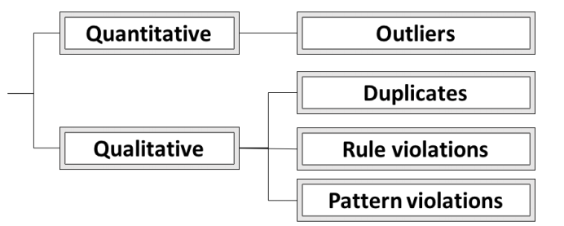
Types of Data Errors

Slide 6
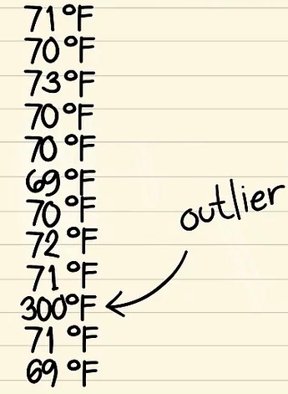
Outliers

Slide 7
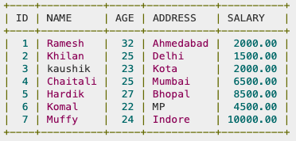
Duplicates

Slide 8
Rule Violation
Refer to values that violate any kind of integrity constraints, such as Not Null constraints and Uniqueness constraints

Slide 9
Patter Violation
Refer to values that violate syntactic and semantic constraints

Slide 10
Data sets

Slide 11
Data Sets(cont.)
MIT VPF
A procurement database which contains information about vendors and individuals that supply MIT with products and services.
Errors are introduced due to inconsistent formatting
To obtain ground truth for this data set, employees of VPF manually curated a random sample of 13,603 records (more than half of the data set) and marked erroneous fields.

Slide 12
Data Sets(cont.)
Merck
A data set that describes IT services and software systems within the company that are managed by third parties.
Errors are introduced as different parties adds information to the database which creates colomns that are not consistently formatted.
Merck provided the custom cleaning script that they used to produce a cleaned version of the data set and used this version as ground truth

Slide 13
Data Sets(cont.)
Animal
Data set was provided by scientists at UC Berkeley who are studying the effects of firewood cutting on small terrestrial vertebrates.
Data is entered manually
Errors such as shifted fields and wrong numeric values were introduced to the data set
Scientists identified and corrected several hundreds erroneous cells in the data set.
We use the manually cleaned data set as ground truth.

Slide 14
Data Sets(cont.)
Rayyan Bib
Database which consists of systematic reviews.
Users searches multiple databases using multiple queries
Prone to errors as reference are coming from outside and user can manually manipulate these citations.
To obtain ground truth, Manually checked 1000 references from rayyans database and marked erroneous cells

Slide 15
Data Sets(cont.)
BlackOak
Address database
Errors in this database are randomly distributed
Included to study the difference in error detection performance between real-world address data sets and a synthetic data set

Slide 16
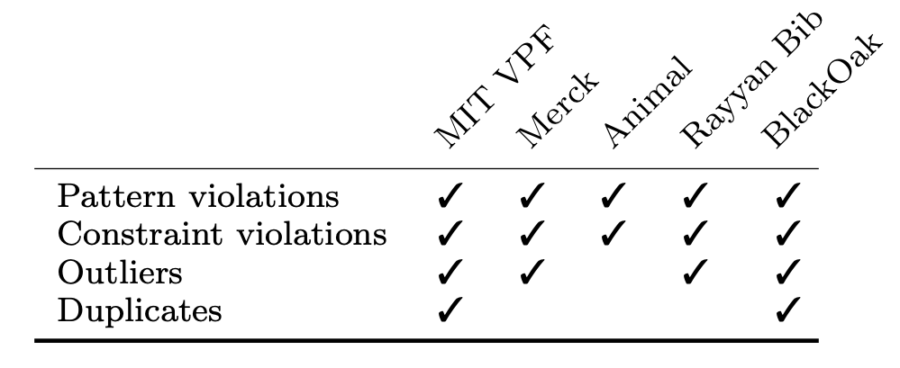
Errors types present in the data sets

Slide 17
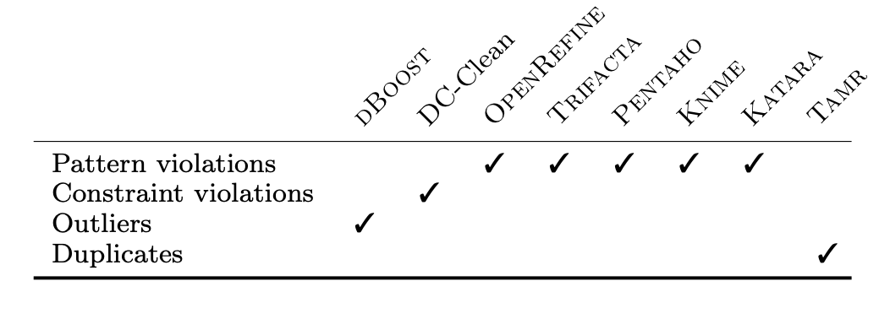
Data Cleaning Tools

Slide 18
Outlier Detection
Tools detect data values which do not follow statistical distributionD
Dboost uses integrates several algorithms like histograms, Gaussian and multivariate Gaussian mixtures which are widely used for Outlier detection.
DBoost decomposes run-on data types into their constituent pieces.

Slide 19
Rule-based Error Detection
Tools detect error by depending on data quality rules.
Used DC-clean which focuses on denial constraints.
DC supports commonly used constraint languages.

Slide 20
Pattern-based Detection
OpenRefine is an open source data wrangling tool
It has faceting and filtering operations
user gives one column for faceting and OpenRefine generates a widget that has all distinct values in this column and their number of occurrences
Also, has editing operation in which user can edit one cell at a time and can also edit a text facet and all cells will be updated.

Slide 21
Pattern-based Detection(Cont.)
Trifacta is the commercial descendant of data wrangler.
Can predict and apply various syntactic data transformations for data preparations and data cleaning
Uses frequent analysis to apply most and least frequent values.
Can map each column to prominent data type and identifies values which do not fit the data type

Slide 22
Pattern-based Detection(Cont.)
KATARA depends on external knowledge base like Yago and detects and corrects error which violate a semantic pattern
Identifies the type of a column and relations between two columns and validates the value using the knowledge database.

Slide 23
Pattern-based Detection(Cont.)
Pentaho provides a graphical interface where the data wrangling process can be orchestrated through creating a directed graph of ETL operations.
Any data manipulation or rule validation operation can be added as a node into the ETL pipeline.

Slide 24
Pattern-based Detection(Cont.)
KNIME integrates various components for machine learning and data mining through its modular data pipelining concept

Slide 25
Duplicate Detection
Tamr is based on machine learning models that learn duplicate features through expert sourcing and similarity metrics.

Slide 26
Combination of Multiple Tools
Union All and Min-k
Union all takes the union of the errors emitted by all tools
Min-k considers as errors those errors detected by at least k-tools while excluding those detected by less than k tools

Slide 27
Combination of Multiple Tools(Cont.)
Ordering Based on precision
Performance of a tool can be measured by precision and recall in detecting errors
Difficult to compute recall without knowing the errors
Easy to estimate precision precision and acts as a proxy for the importance of the tool
Designed an algorithm to estimate the precision for each tool.

Slide 28
Experiments
Evaluation Metrics
Efficency of of the tool is determined by the accuracy in finding the potential errors using precision and recall, defined as follows:

Slide 29
Experiments(Cont.)
Individual Tools Effectiveness

Slide 30
Experiments(Cont.)
Tool Combination Effectiveness
Higher recall but the precision suffer significantly
To maximize precision a natural approach is to use a min-k voting system.
But increasing K will increase precision and lose recall.

Slide 31
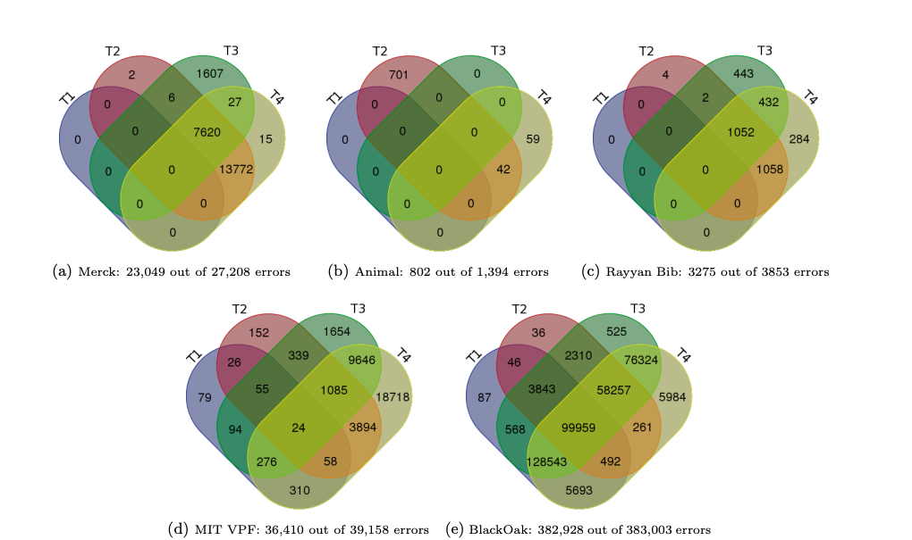

Slide 32
Experiments(Cont.)
The main problem of the min-k approach is that it depends on a manually picked k, which can depend on the given data set and the set of tools.

Slide 33
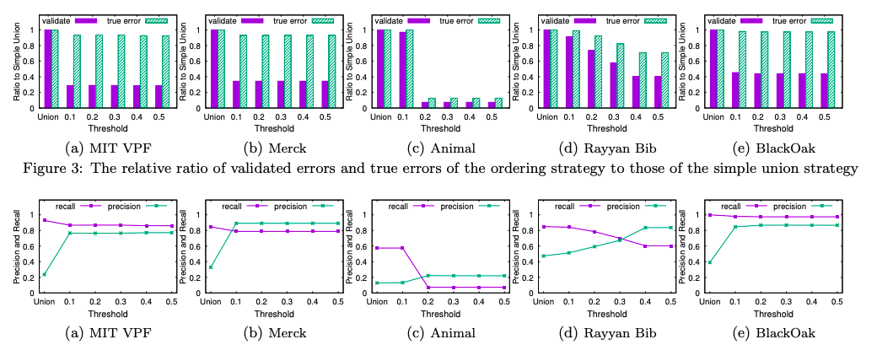
Experiments(Cont.)
Ordering based on Benefit and User Validation

Slide 34
Domain Specific Tools

Slide 35
Enrichment

Slide 36
Conclusions
There is no single dominant tool for the various data sets and diversified types of errors.
Picking the right order in applying the tools can improve the precision and help reduce the cost of validation by humans.
Domain specific tools can achieve high precision and recall compared to general-purpose tools.
Rule-based systems and duplicate detection benefited from data enrichment.

Slide 37
Thank You!

