Slide 1
Differential Privacy
December 2, 2014
Presented by:
Praveen Ilango

Slide 2
Required Reading
A firm foundation for private data analysis. Dwork, C. Communications of the ACM, 54(1), 86-95. 2011.
Privacy by the Numbers: A New Approach to Safeguarding Data. Erica Klarreich. Scientific American, December 31 2012.

Slide 3
A firm foundation for private data analysis
Cynthia Dwork, (PhD Cornell, 1983)
Distinguished Scientist at Microsoft Research

Slide 4
“A firm foundation”
Motivation: privacy with statistical databases.
Past attempts at privacy.
Creating privacy using noise.
Defining differential privacy.
Achieving differential privacy.
Properties of differentially private queries.

Slide 5
“A firm foundation”
Motivation: privacy with statistical databases.
Past attempts at privacy.
Creating privacy using noise.
Defining differential privacy.
Achieving differential privacy.
Properties of differentially private queries.

Slide 6
1. Motivation
“Anonymous” datasets have been connected to specific individuals.
  AOL search histories.
  Massachusetts state employee medical records.
  Human genetic datasets.
All of these cases involved auxiliary information.
A technology is required to give incentives (or at least to remove disincentives) to contribute to these datasets.
  “First, do no harm.”

Slide 7
Statistical databases
The purpose of a statistical database is to inform.
By definition, these databases will be exposed to users.
A user can, even with good intentions, become an attacker.
The goal is to reveal information, so the right definition of privacy is not obvious.

Slide 8
Dalenius’s Desideratum
An attempt at a workable definition of privacy in this setting:
“Anything that can be learned about a respondent from the statistical database should be learnable without access to the database.”
Naturally relates to semantic security in cryptosystems.

Slide 9
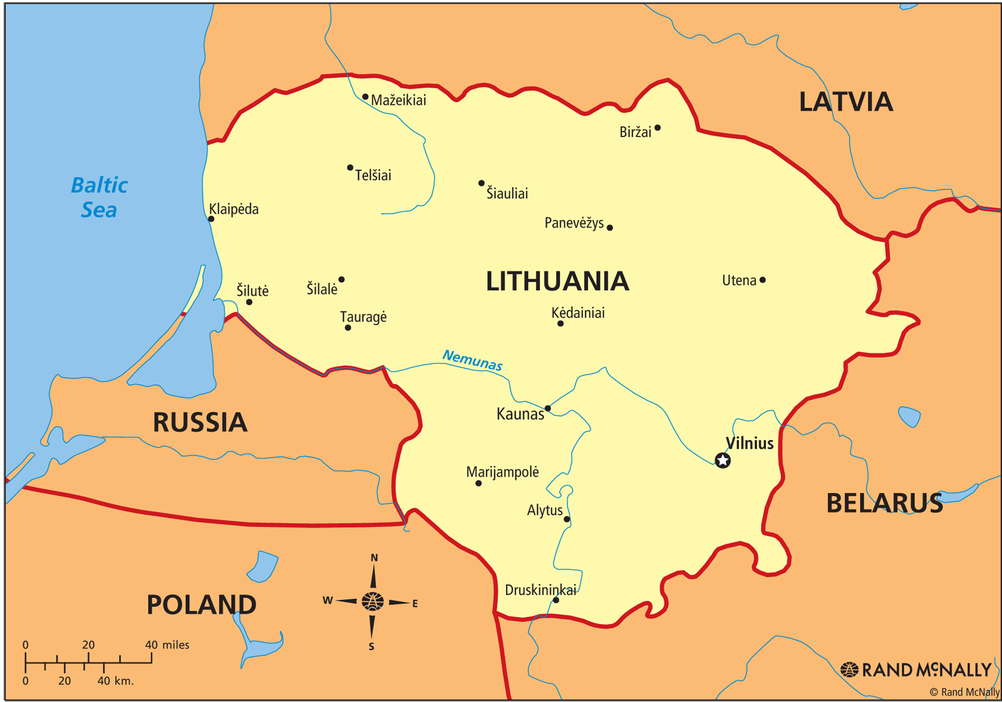
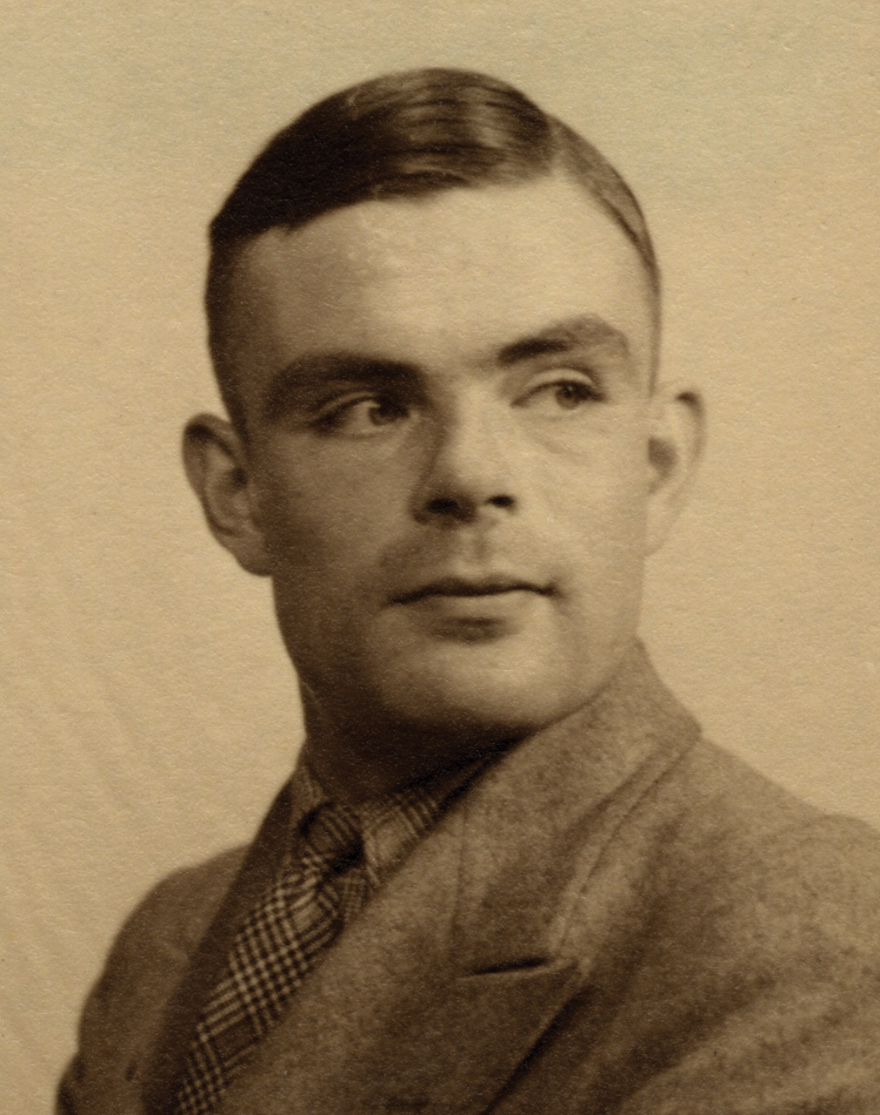
Dalenius’s Desideratum
“Turing
parable”
This has been extended to a general proof of the inadequacy of this definition.
This definition fails as it punishes the database for revealing information, which is the purpose of a statistical database.

Slide 10
“A firm foundation”
Motivation: privacy with statistical databases.
Past attempts at privacy.
Creating privacy using noise.
Defining differential privacy.
Achieving differential privacy.
Properties of differentially private queries.

Slide 11
2. Past attempts
Large query sets: Forbid queries about specific individuals.
  Non-specific queries can still reveal information.
Query auditing: Determine by analysis if a set of queries will reveal information about individuals.
  Computationally infeasible in general [J. Kleinberg et al.].
  Rejecting a query leaks information.
Subset sampling: Release only a subset of the dataset.
  Punishes individuals in the subsample

Slide 12
2. Past attempts
Input perturbation: Choose a subsample based on the query and compute the response on that subsample.
  Does not protect outliers.
Randomized response: Randomize the data at collection time. “Randomize once.”
  Does not work with complex data.
Random noise: Add random noise to query responses.
  If done naively, easy to defeat.

Slide 13
“A firm foundation”
Motivation: privacy with statistical databases.
Past attempts at privacy.
Creating privacy using noise.
Defining differential privacy.
Achieving differential privacy.
Properties of differentially private queries.

Slide 14
Two problems
We do not have a good definition of privacy in this setting.
  How can we make progress without one?
Past attempts to achieve some kind of privacy did not work.

Slide 15
Blatant non-privacy
A system is blatantly non-private if an adversary can construct a replica database that matches the real database in 99% of its entries.
The adversary gets at most 1% wrong.
Of past approaches, adding random noise did not work if done naively, but perhaps we can fix it.
How much noise must be added by our database mechanism to avoid blatant non-privacy?

Slide 16
Theorem 1: Let M be a mechanism that adds noise bounded by E. Then there exists an adversary that can reconstruct the database to within 4E positions.
To avoid blatant non-privacy, we must add noise bounded by n/400. A bound of n/401 or lower is provably non-private.

Slide 17
Noise and the “noisy table”
Our analysis demonstrates that we cannot release a static “noisy table” that can be used to get very accurate statistics about the real data.
  A table that can give accurate statistics can be attacked.
  A table that cannot be attacked cannot give accurate statistics.
This yields a key conclusion: we can only achieve both privacy and accurate statistics with an interactive database mechanism.

Slide 18
Privacy goal
We considered already Dalenius’s definition of privacy and saw that it is inadequate.
Because statistical databases are intended to reveal information and because we want to ensure participation in these databases, we require a special definition of privacy.
Our goal is to minimize the increased risk to an individual incurred by joining or leaving the database.
This goal leads us directly to differential privacy.

Slide 19
“A firm foundation”
Motivation: privacy with statistical databases.
Past attempts at privacy.
Creating privacy using noise.
Defining differential privacy.
Achieving differential privacy.
Properties of differentially private queries.

Slide 20
Differential privacy
It should not harm you or help you as an individual to enter or to leave the dataset.
To ensure this property, we need a mechanism whose output is nearly unchanged by the presence or absence of a single respondent in the database.
In constructing a formal approach, we concentrate on pairs of databases (D, D’) differing on only one row, with one a subset of the other and the larger database containing a single additional row.

Slide 21
Differential privacy

Slide 22
Differential privacy
An equivalent expression of this idea is given as a ratio bounded by R:
The closer R is to 1, or εto 0, the more difficult it will be for an attacker to determine an individual’s data.
εis a publicly known characteristic of our database. It defines the level of privacy maintained and it informs users of the amount of error to expect in the responses it yields.

Slide 23
Differential privacy
An important property of this definition is that any output with zero probability is invalid for all databases.
  An output with a probability of zero in a given database must have a probability of zero in both neighboring databases and by induction, in any other database as well.
It immediately follows that sub-sampling fails to implement differential privacy.
  A row cannot be present in a sub-sample if that person has previously left the dataset.
With this definition in hand, we can attempt an implementation.

Slide 24
“A firm foundation”
Motivation: privacy with statistical databases.
Past attempts at privacy.
Creating privacy using noise.
Defining differential privacy.
Achieving differential privacy.
Properties of differentially private queries.

Slide 25
Noise properties
We know we can add noise to query responses to disguise the true contents of the database.
We know the level of disguise required for differential privacy.
What distribution should we employ to generate this noise?

Slide 26
Simple case
“How many rows in the database satisfy P?”
Adding or removing a row can only change the answer by 1.
To build a differentially private mechanism for answering this query, we add to the response random noise drawn from a distribution with the property:
We make this requirement so that the noise itself does not leak information beyond our chosen ε.

Slide 27
General case
We must be able to handle vector-valued queries.
To do this, we must consider the sensitivity of the function that will generate the response.
  In the simple case, the sensitivity was 1.
The sensitivity defines the difference that the noise must hide.

Slide 28
Laplace distribution
We generate noise using the Laplace distribution.
The Laplace distribution, denoted Lap(b), is defined with parameter b and has density function:
Taking b = 1/ε we have immediately that the density is proportional to e^{-ε|z|}.
This distribution has its highest density at 0.
For any z, z’ such that |z - z’|≤ 1, the density at z is at most e^{ε} times the density at z’, satisfying the condition we outlined in the simple case.
The distribution is symmetric about 0.
The distribution flattens as εdecreases. More likely to deviate from the true value.

Slide 29
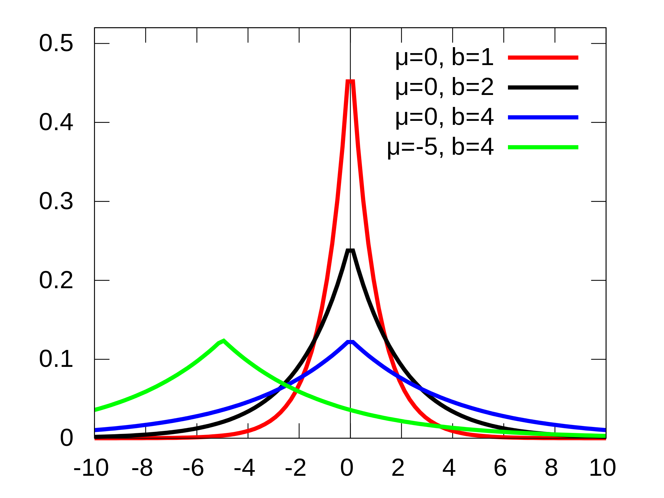
Laplace distribution
Wikipedia, Creative Commons license

Slide 30
Final theorem
In this figure, the distribution on the outputs, show in gray, is centered at the true answer of 100, where Δf = 1 and ε= ln 2. In orange is the same distribution where the true answer is 101.

Slide 32
“A firm foundation”
Motivation: privacy with statistical databases.
Past attempts at privacy.
Creating privacy using noise.
Defining differential privacy.
Achieving differential privacy.
Properties of differentially private queries.

Slide 33
Sequence of queries
We allow the quality of each answer to deteriorate with the sum of sensitivities of the queries, maintaining ε-differential privacy.
A complex query need only be penalized by its aggregate sensitivity. This may be surprisingly small.
  Example: the number of 2-bit rows whose entries are both 1 has sensitivity 1 despite involving 2 bits per row.

Slide 34
Histogram queries
Histogram queries are an example of the aforementioned principle.
The addition or removal of a row can only change the count in a bucket by 1.
This means we need only perturb the count in each bucket according to Lap(Δf /ε) = Lap(1 /ε).
The cost in noise of a query has the desired property: it increases when the query threatens individual privacy and shrinks when the query concerns an aggregate value.

Slide 35
Histogram queries
“This algorithm is a primitive that can be applied to any ‘histogram’ query – that is, one asking how many people fall into each of several mutually exclusive categories, such as first names”
“When [Adam] Smith told Dwork about this insight in the early days of differential privacy research, ‘something inside me went, “Wow!”’ Dwork said. ‘I realized that we could exploit the structure of a query or computation to get much greater accuracy than I had realized.’”
- Scientific American

Slide 36
Sensitivity analysis
To employ this technology for practical data analysis, we rely on the observation that standard datamining queries can be implemented as noisy sums, allowing them to be broken into a series of steps with known sensitivity, giving an aggregate sensitivity for the overall query.
Even queries that are challenging to describe by sensitivity can be performed with ε-differential privacy maintained.
Much of the work done in differential privacy is in the creation of algorithms with low noise cost.

Slide 37
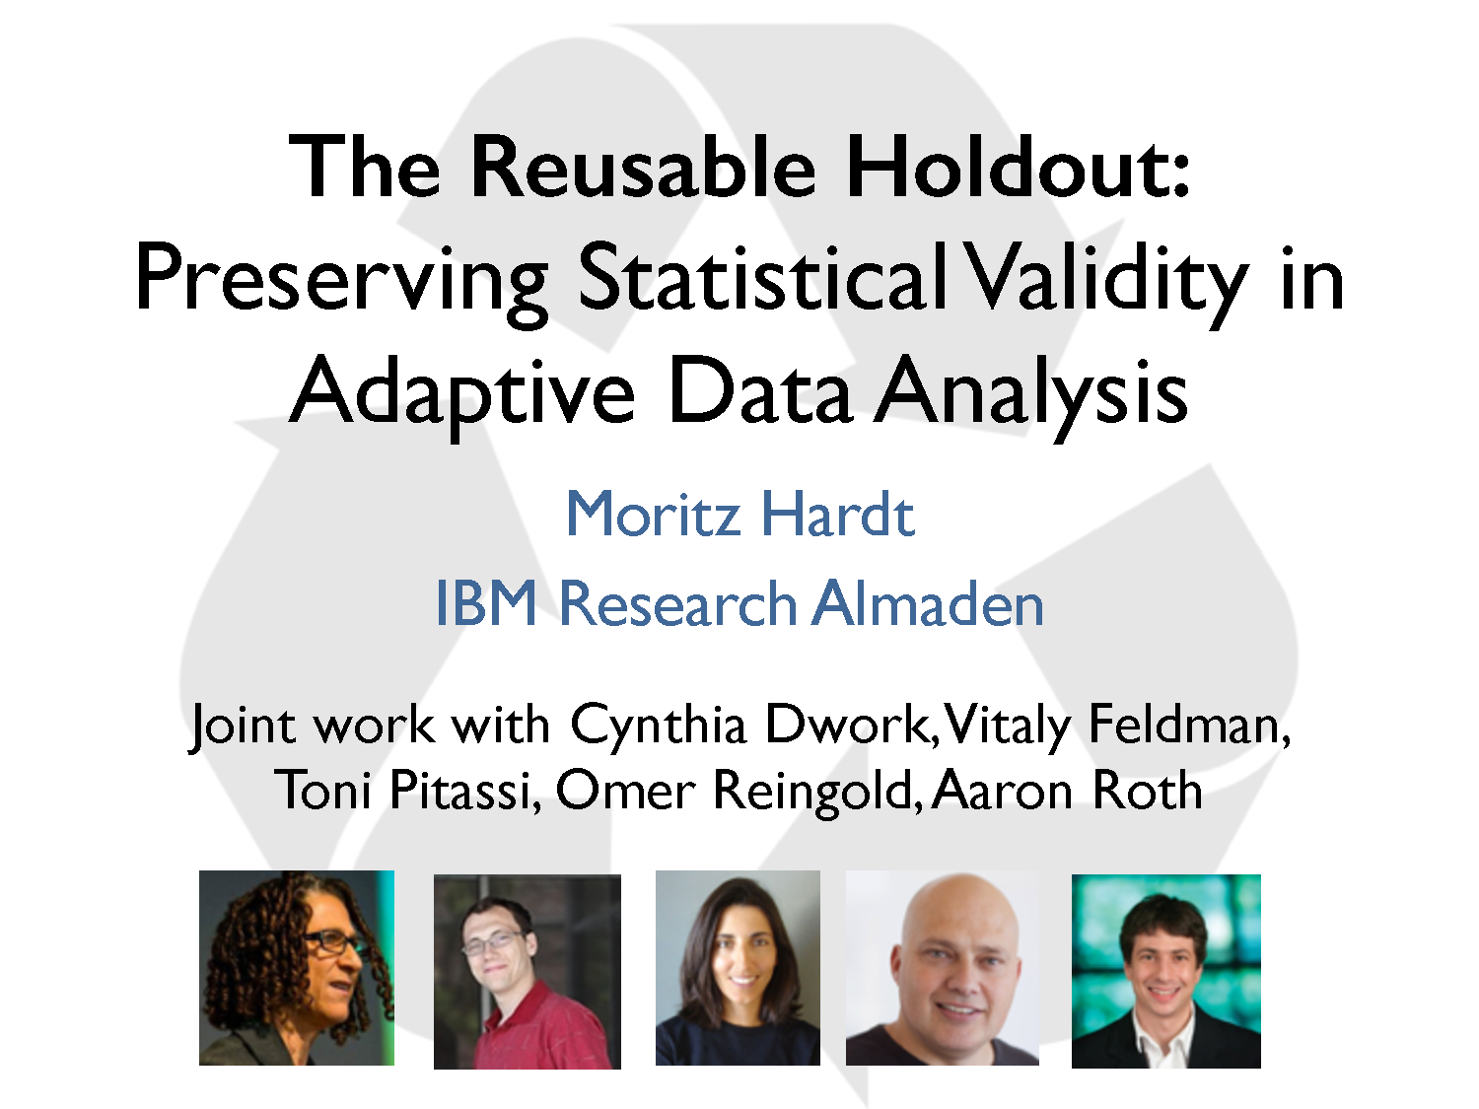

Slide 38
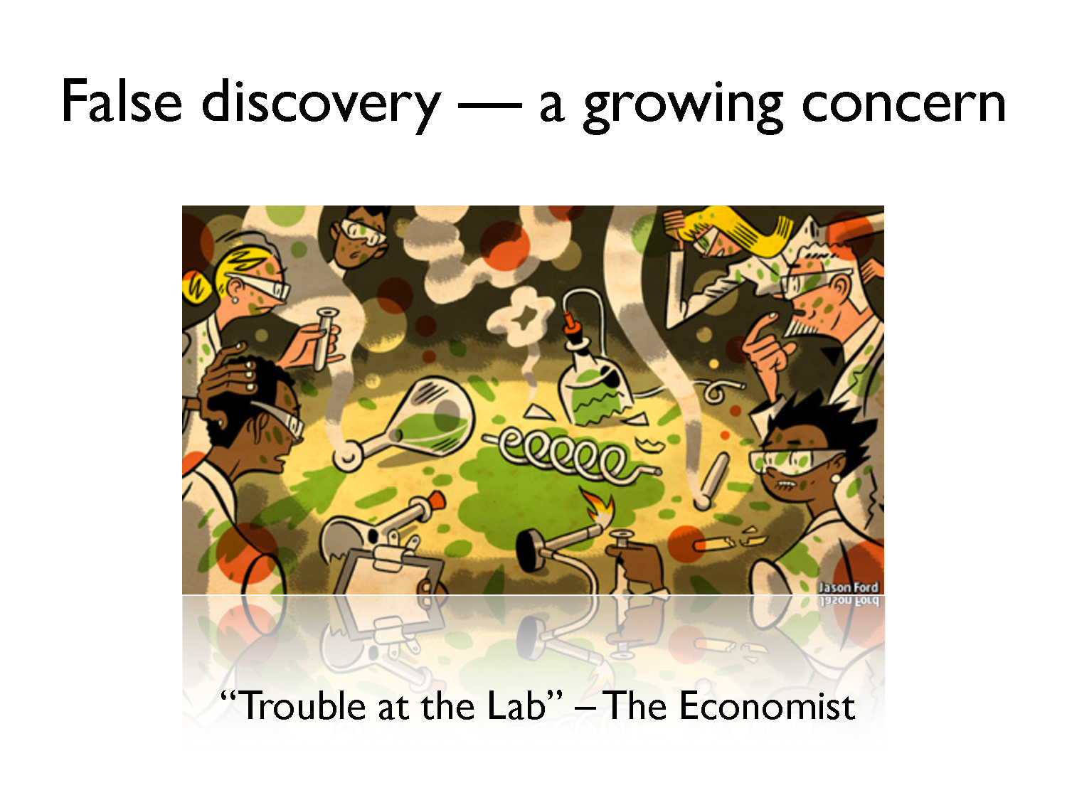

Slide 39
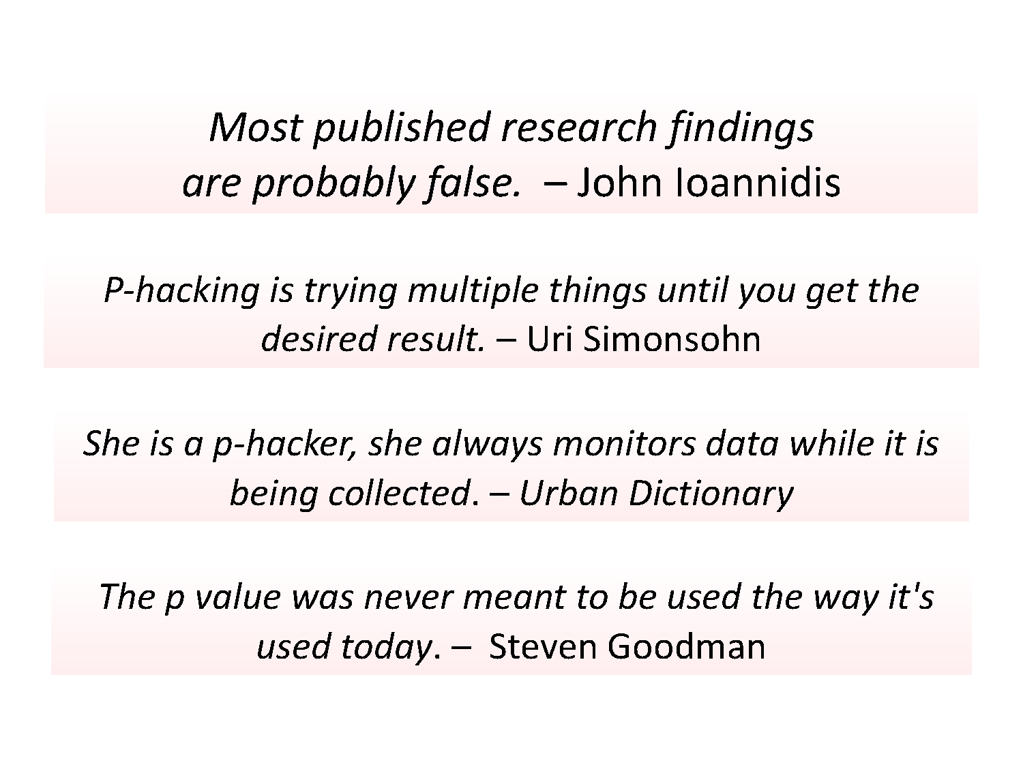

Slide 40
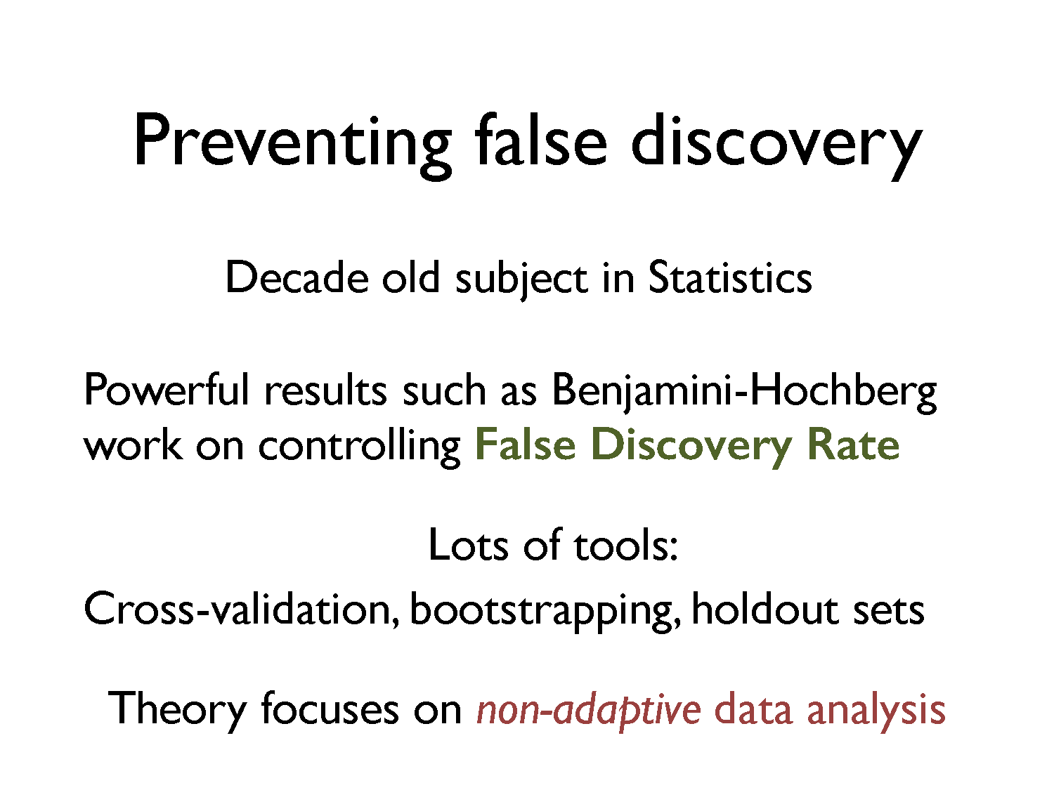

Slide 41
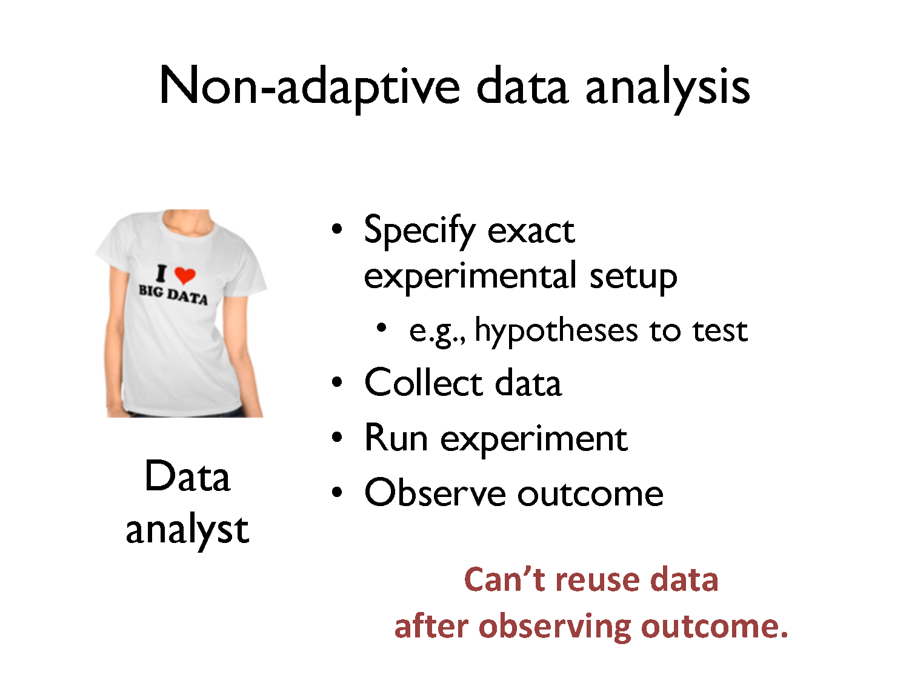

Slide 42
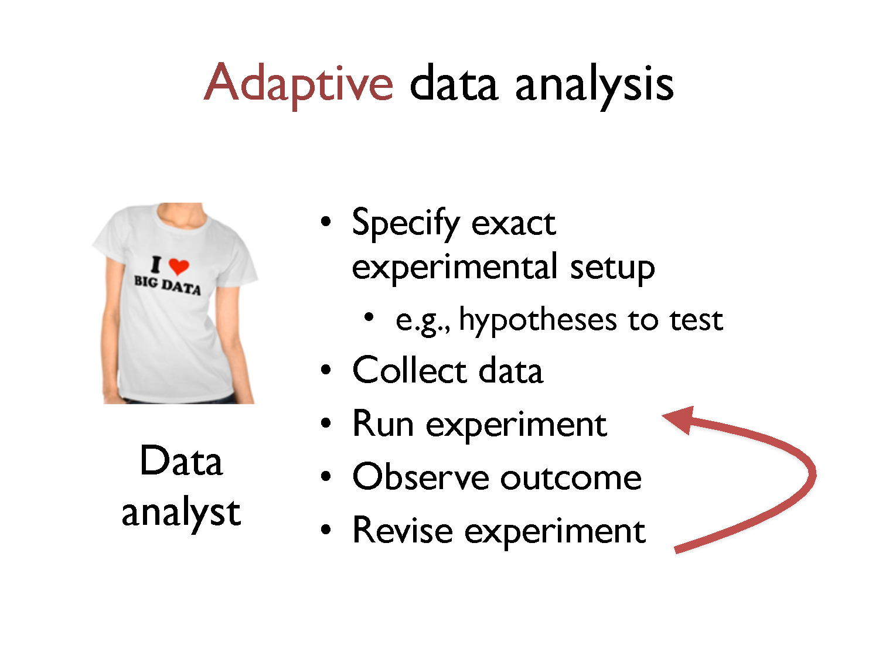

Slide 43
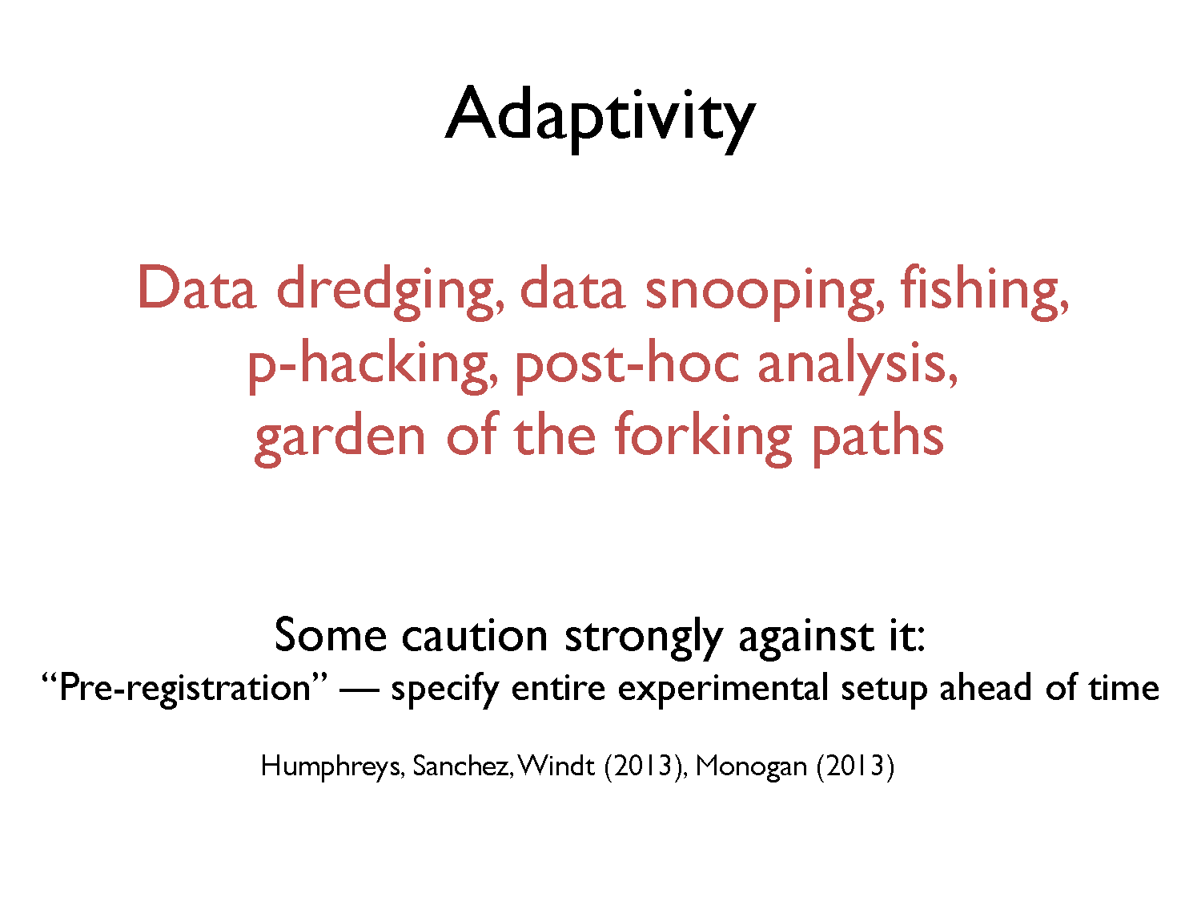

Slide 44
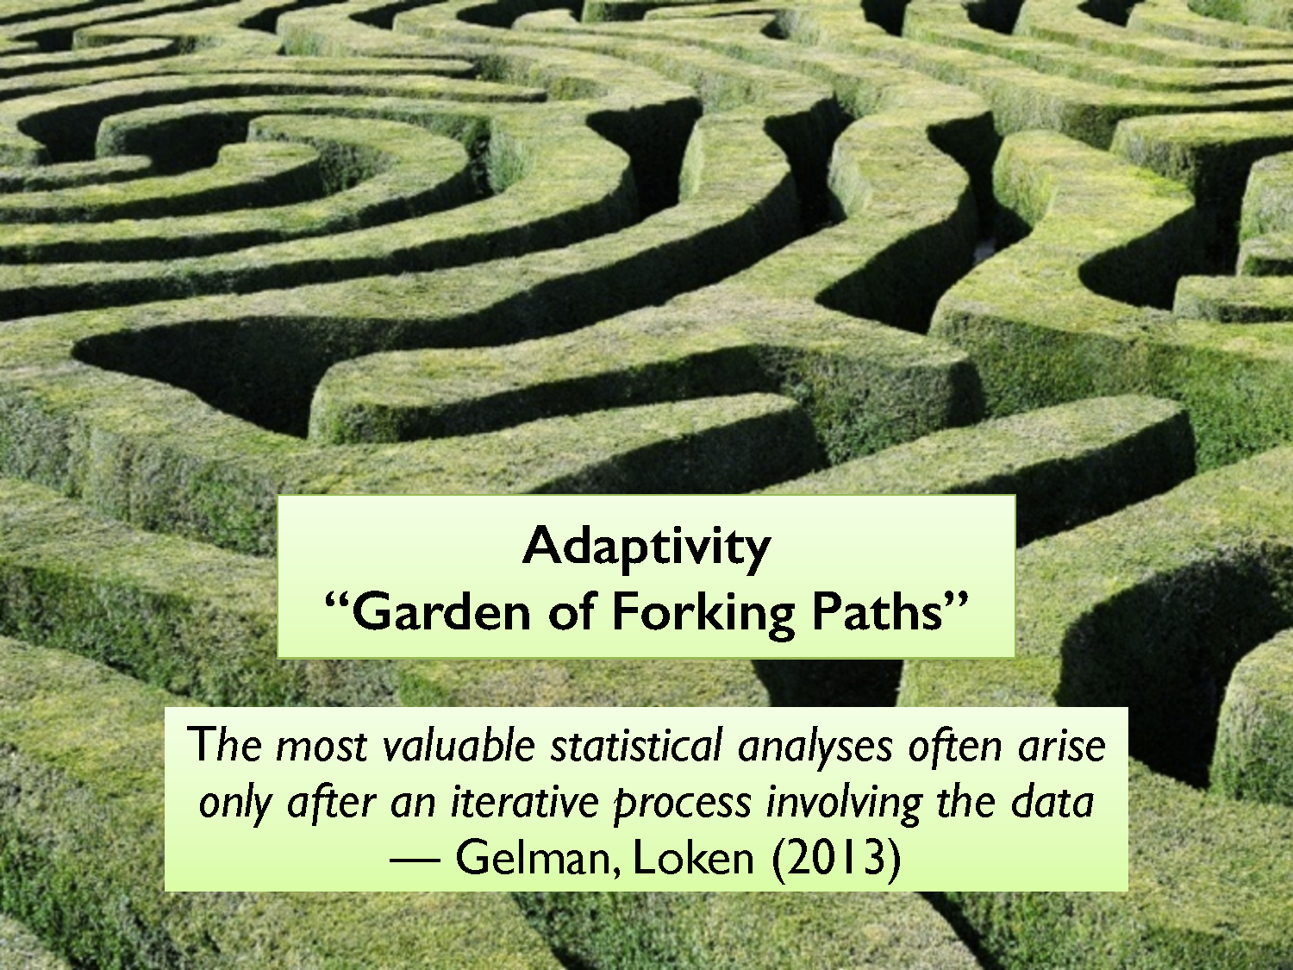

Slide 45
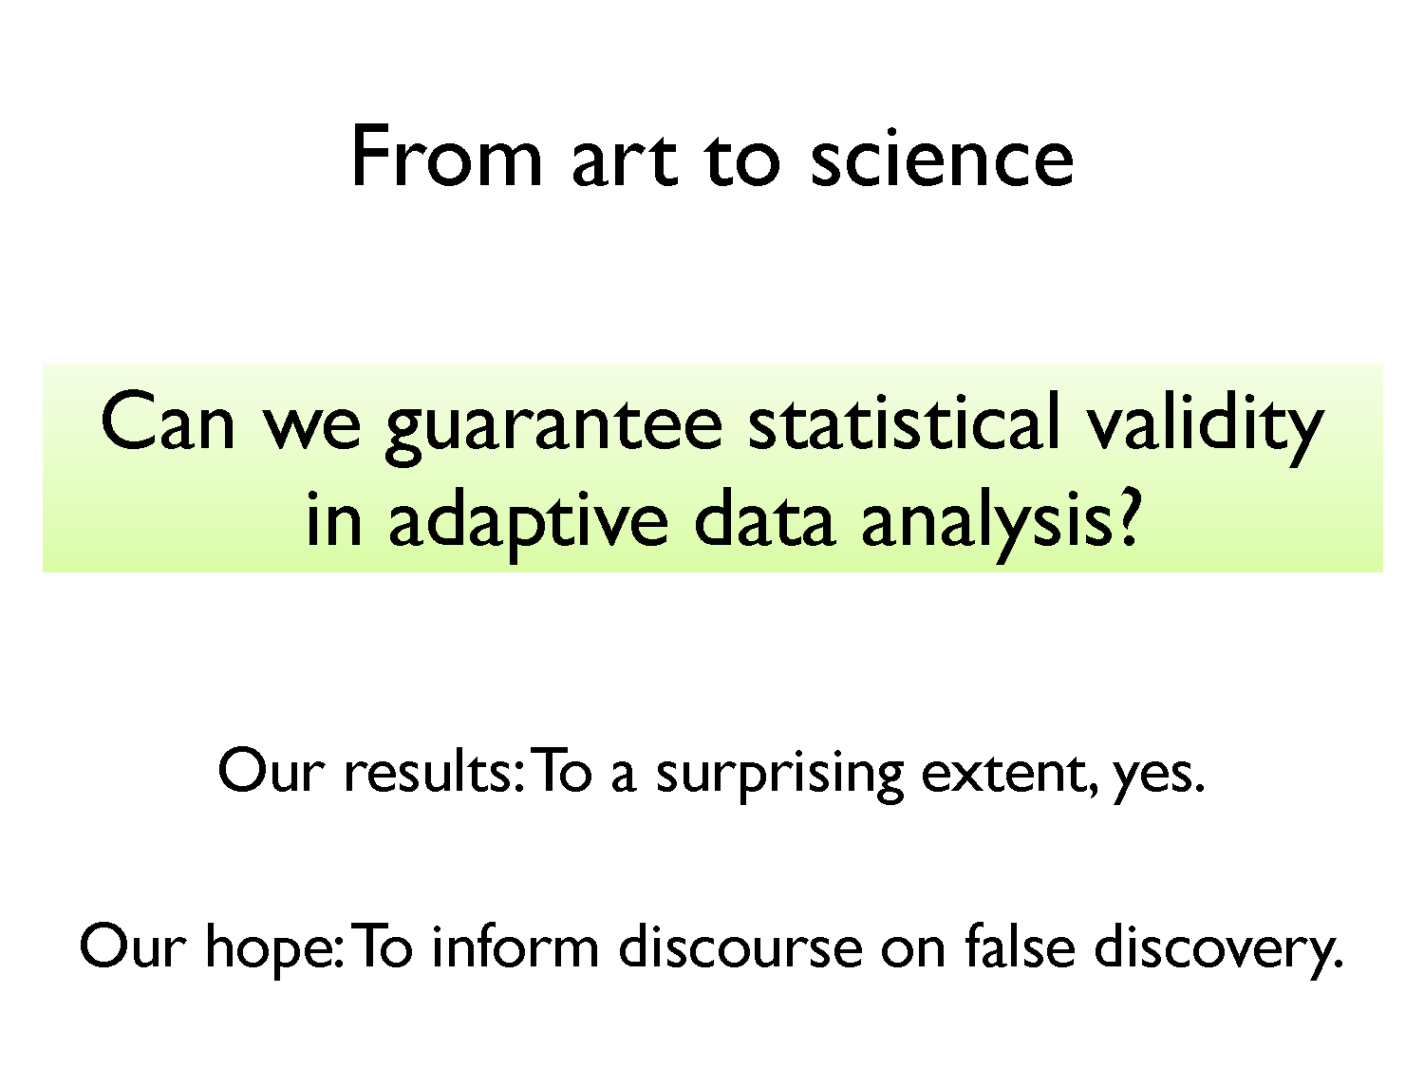

Slide 46
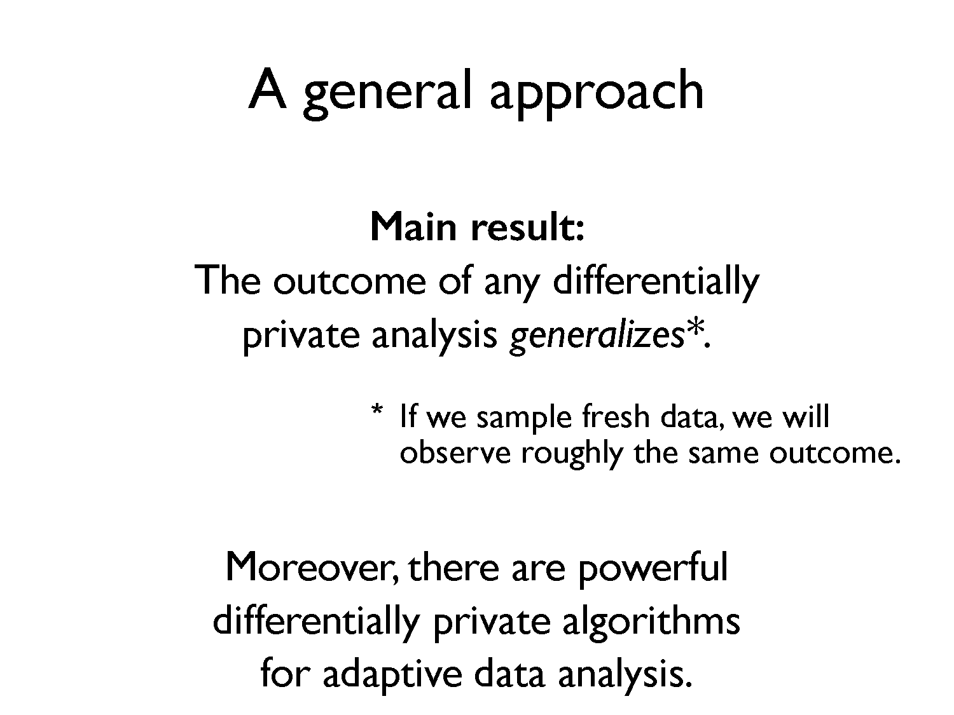

Slide 47
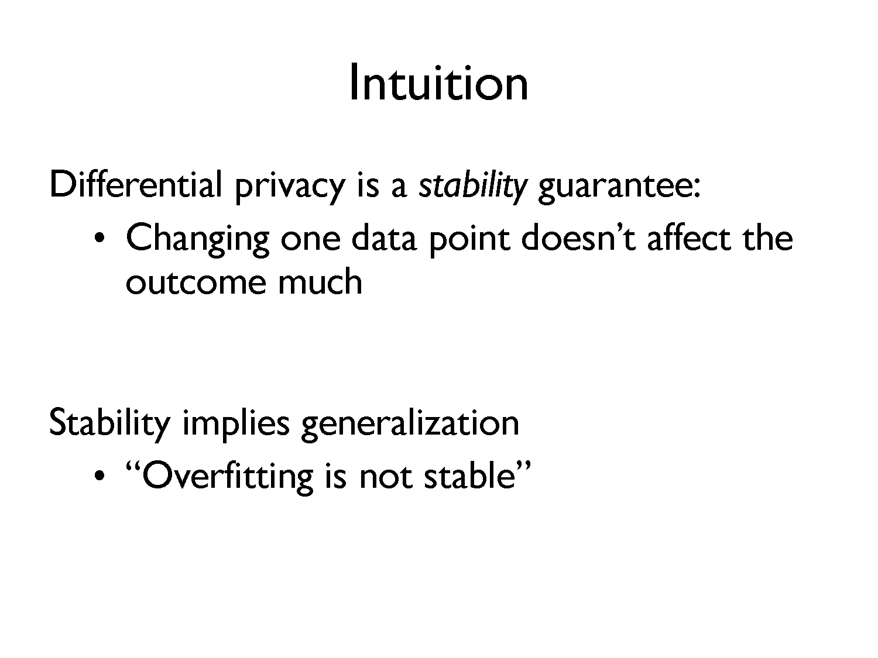

Slide 48
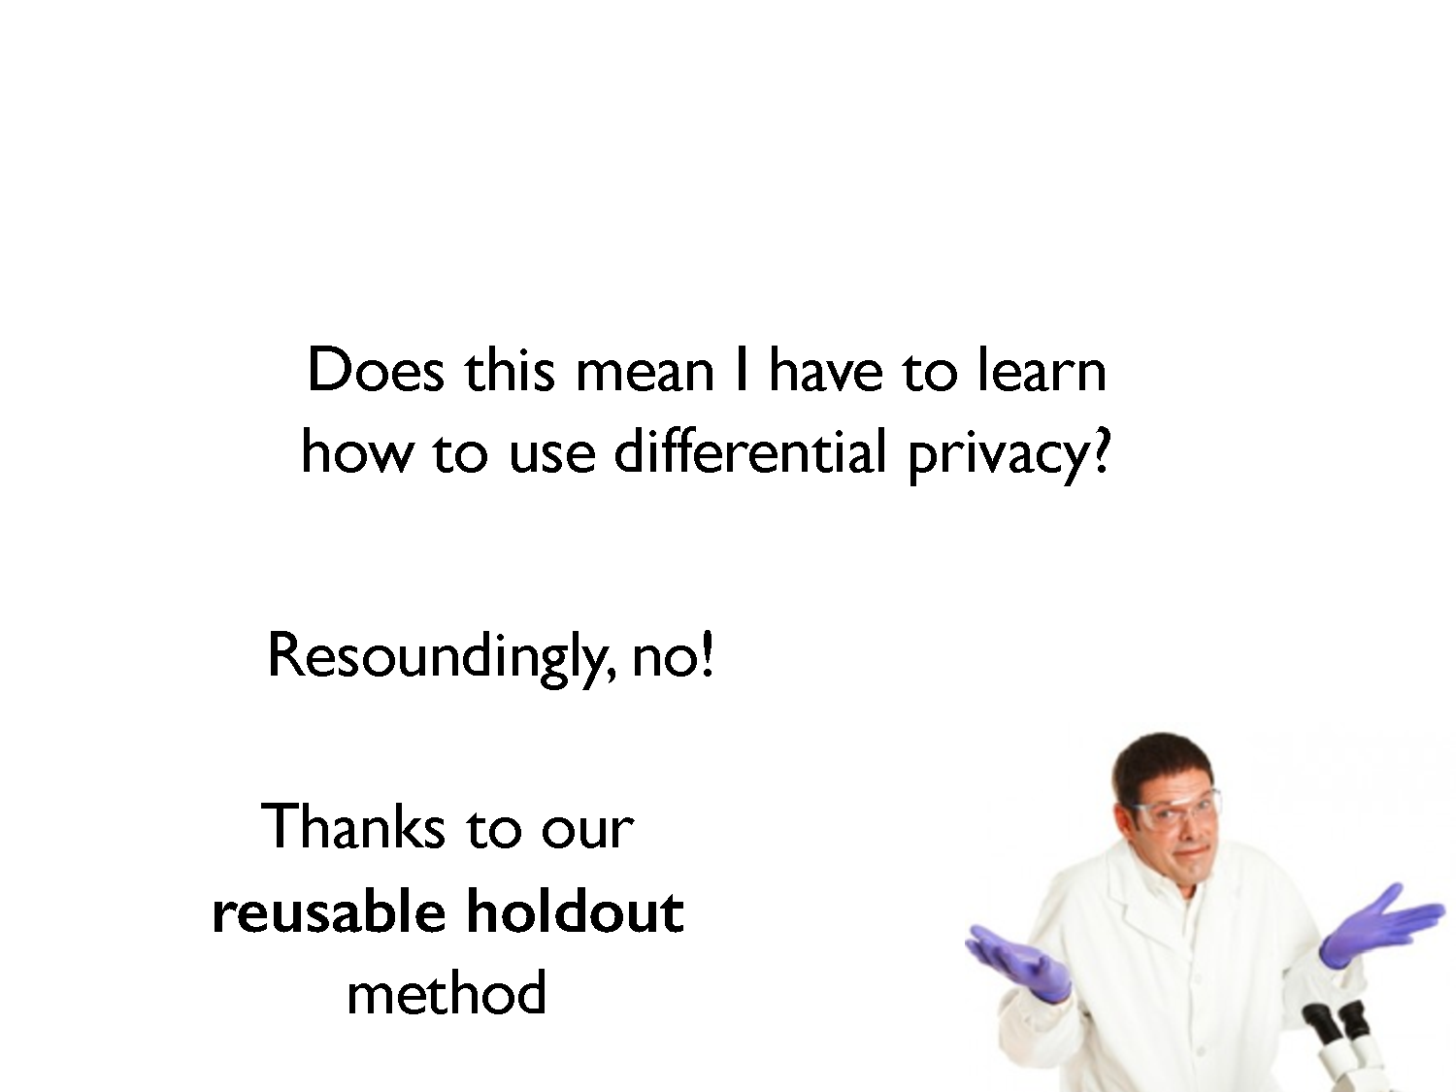

Slide 49
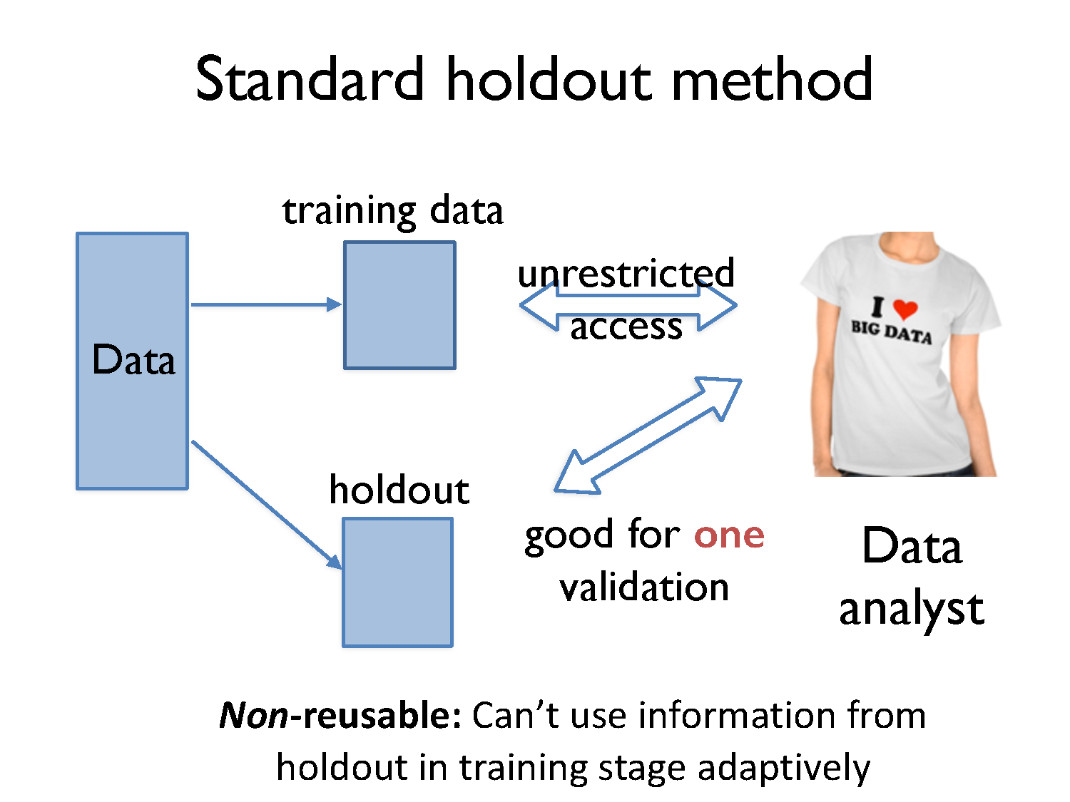

Slide 50
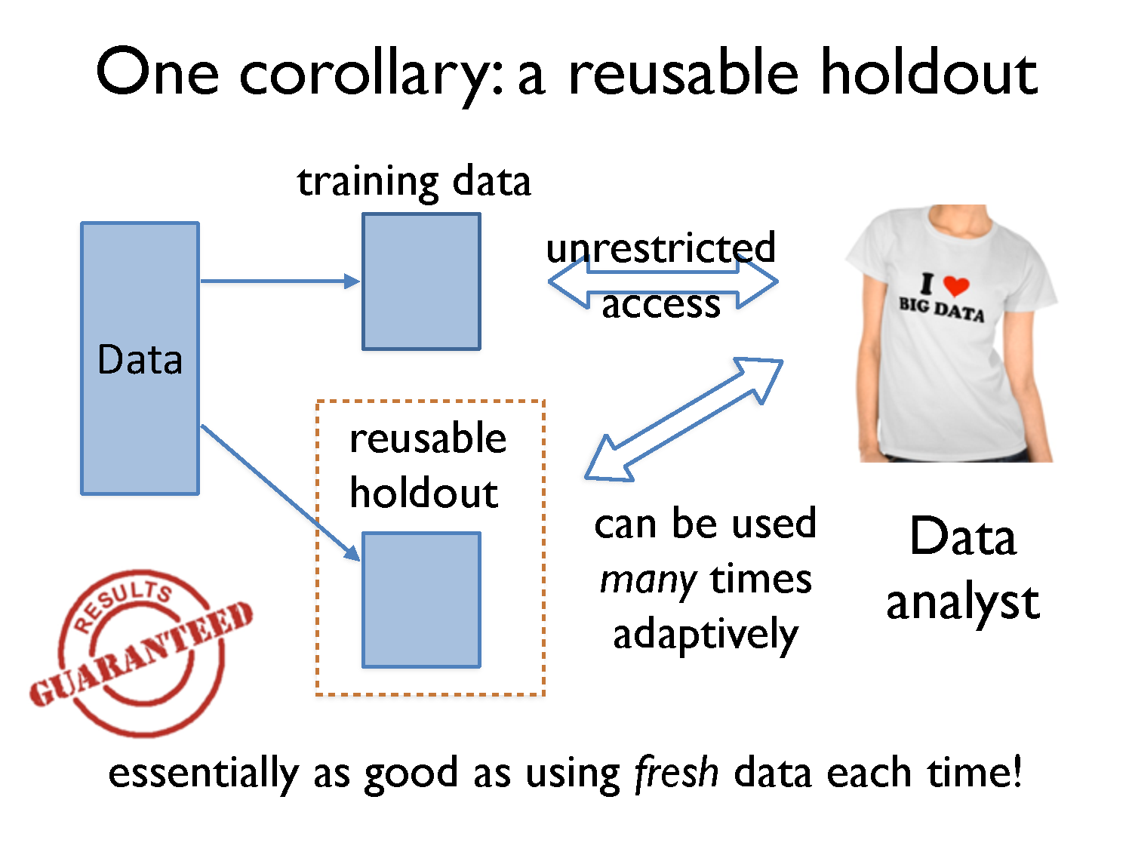

Slide 51
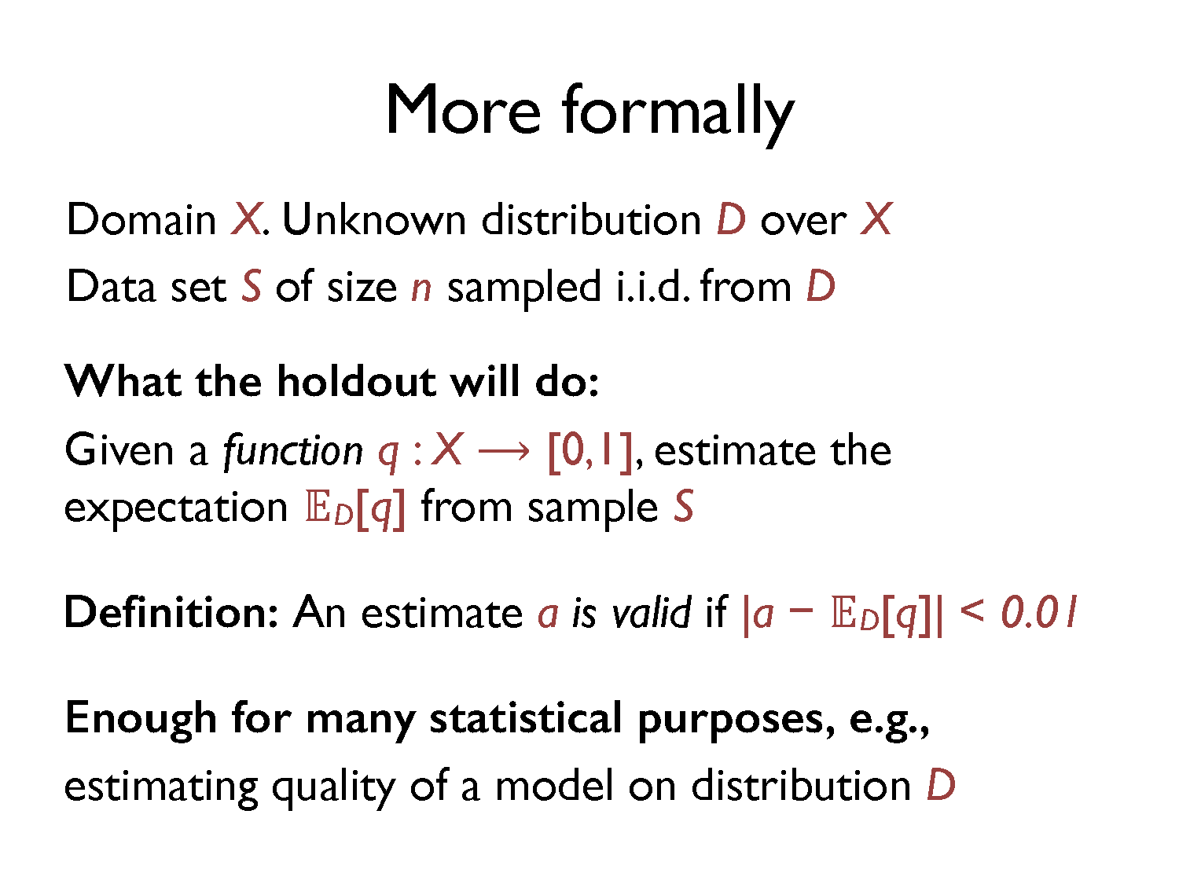

Slide 52
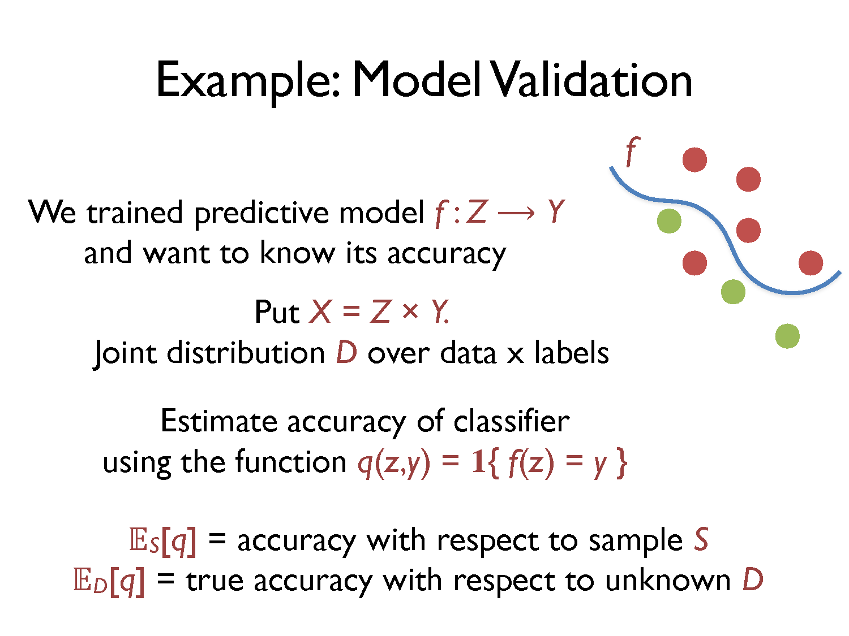

Slide 53
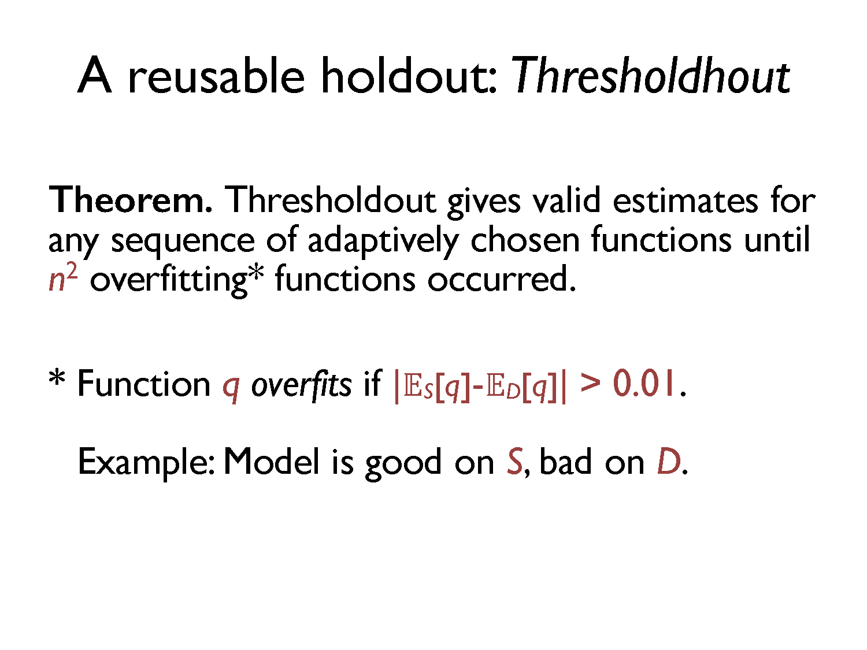

Slide 54
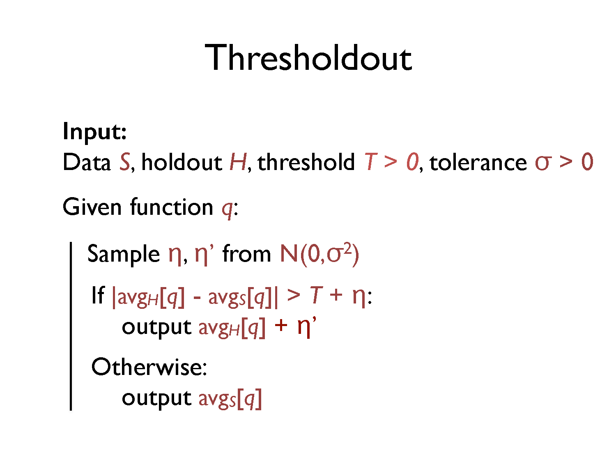

Slide 55
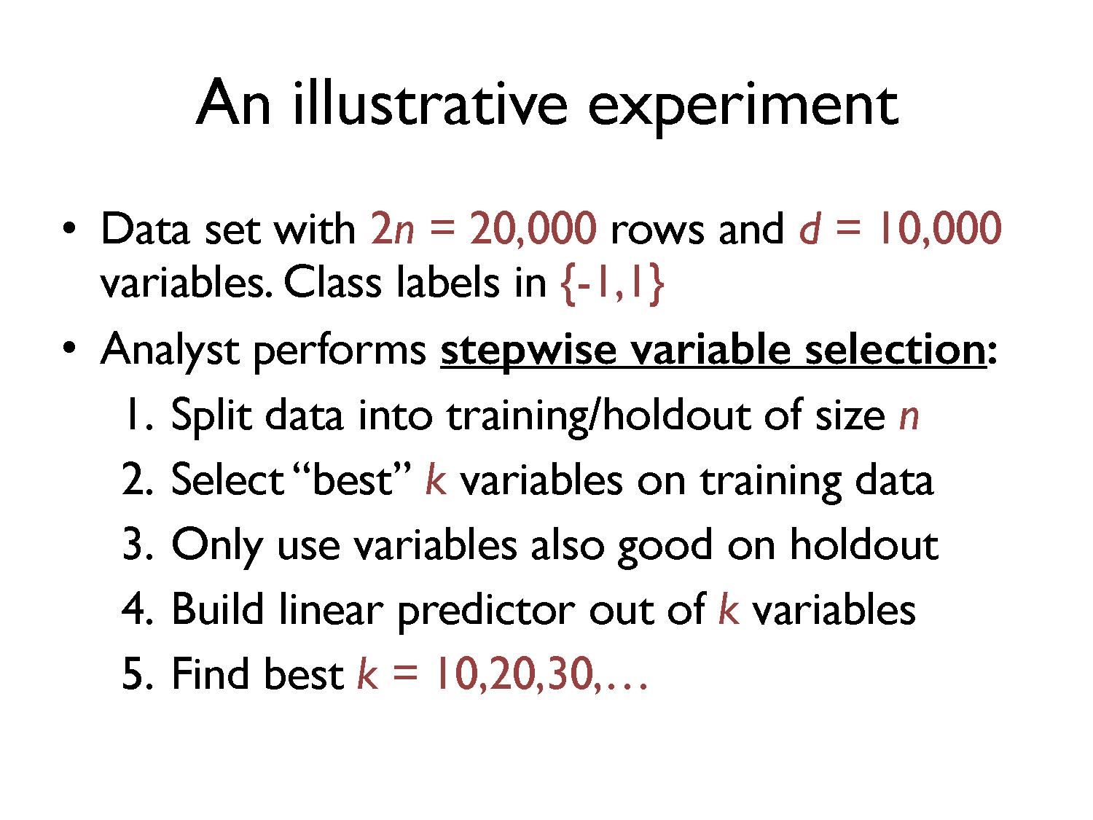

Slide 56
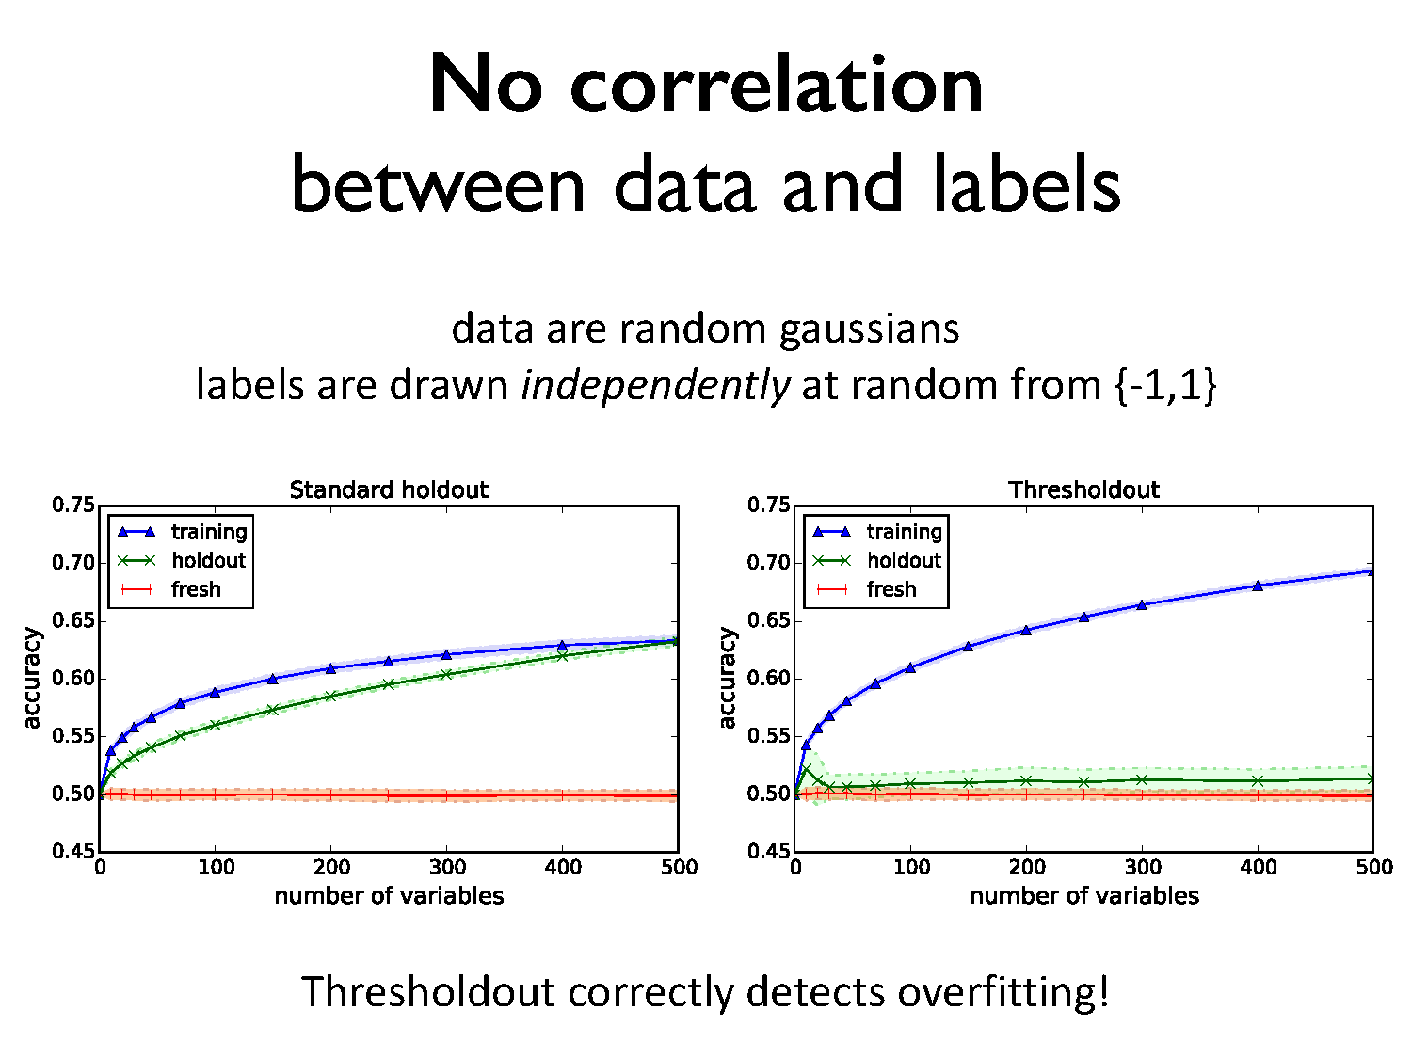

Slide 57
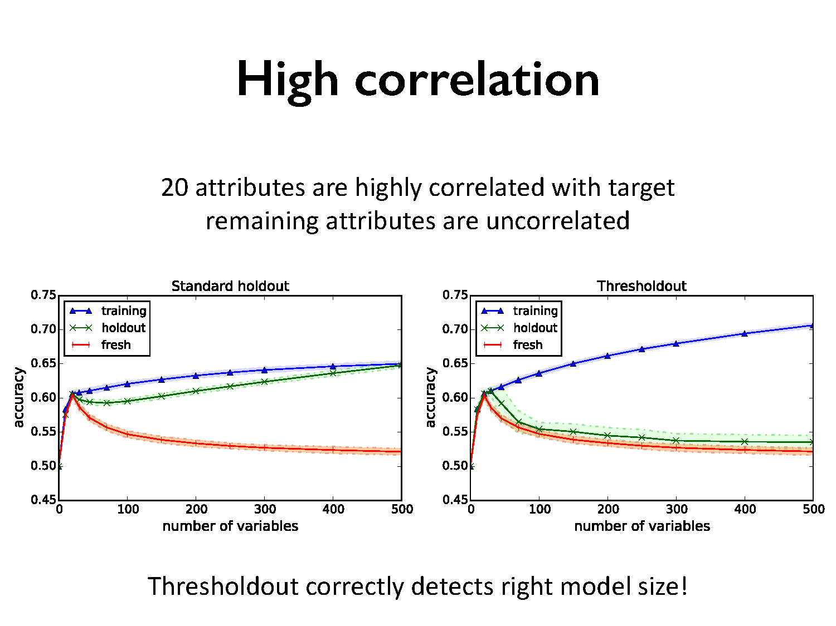

Slide 58
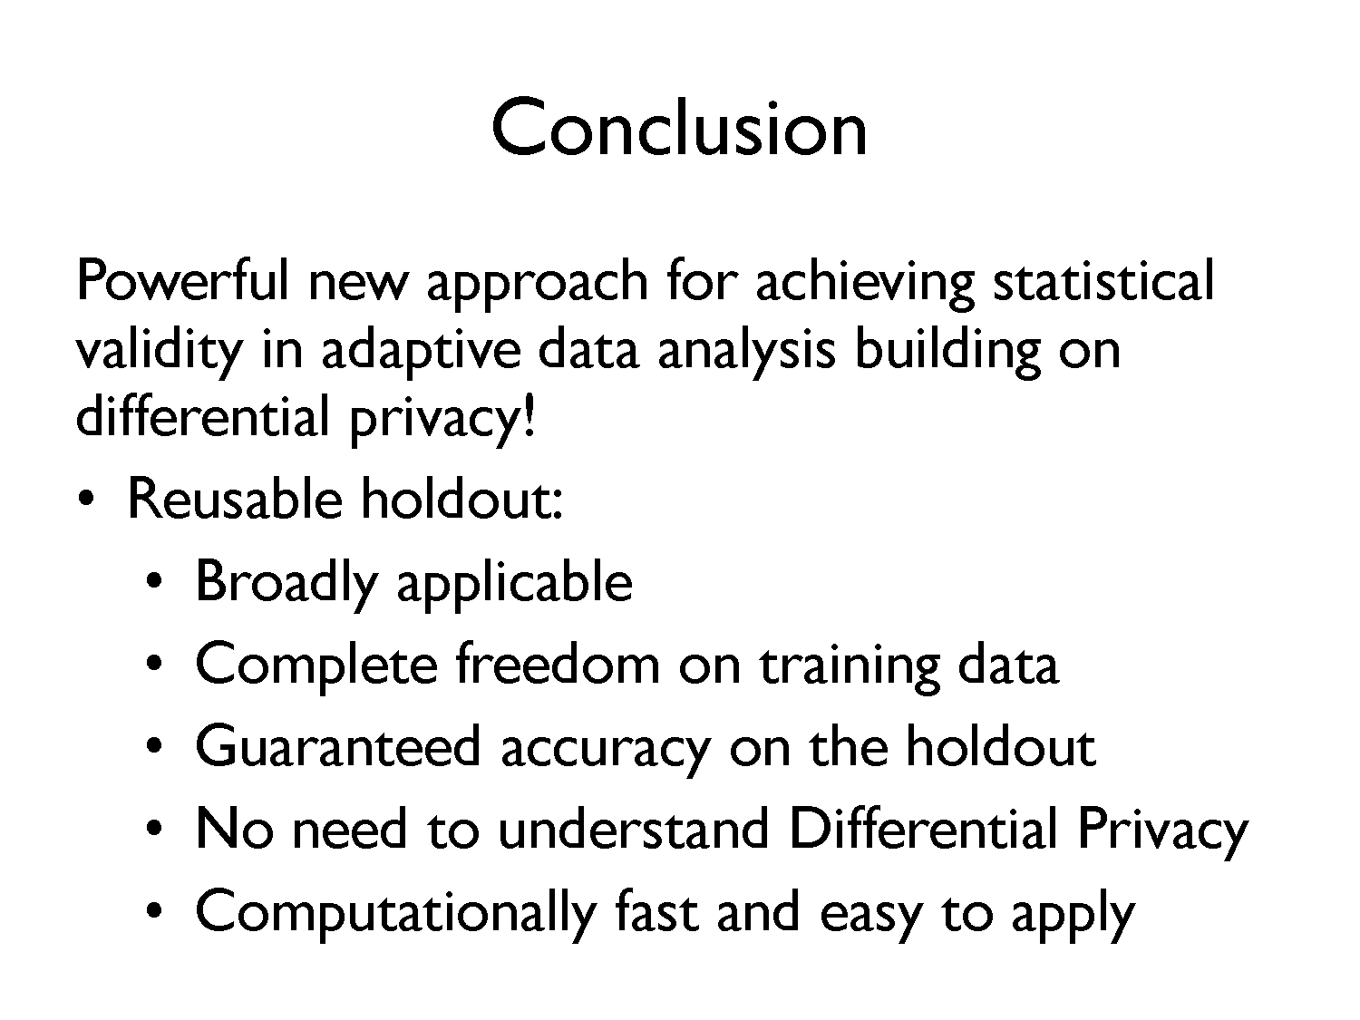

Slide 59
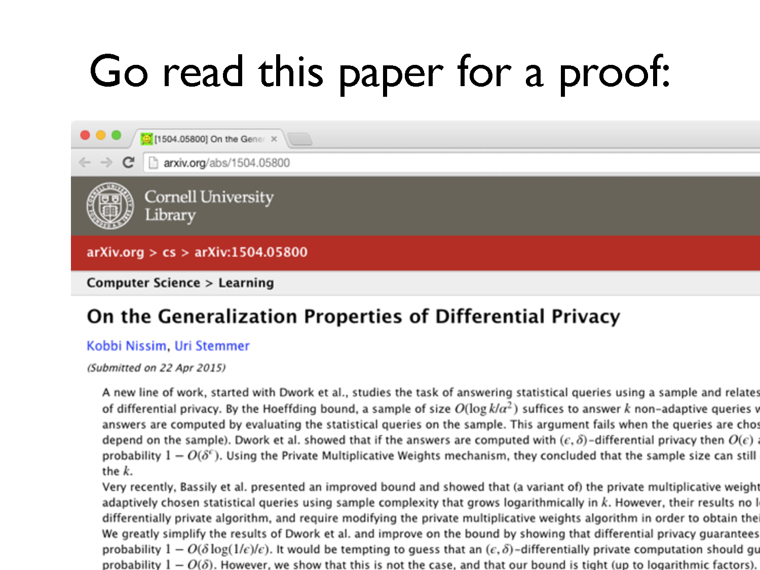

Slide 60


