Slide 1
CS 519
Big Data Exploration and Analytics
Course overview

Slide 2
Welcome to CS519!
Instructor: Arash Termehchy
Assistant Professor at EECS
Research on data management and analytics
Information & Data Management and Analytics (IDEA) Lab
Your turn:
  Name, field, DB and ML/AI background

Slide 3
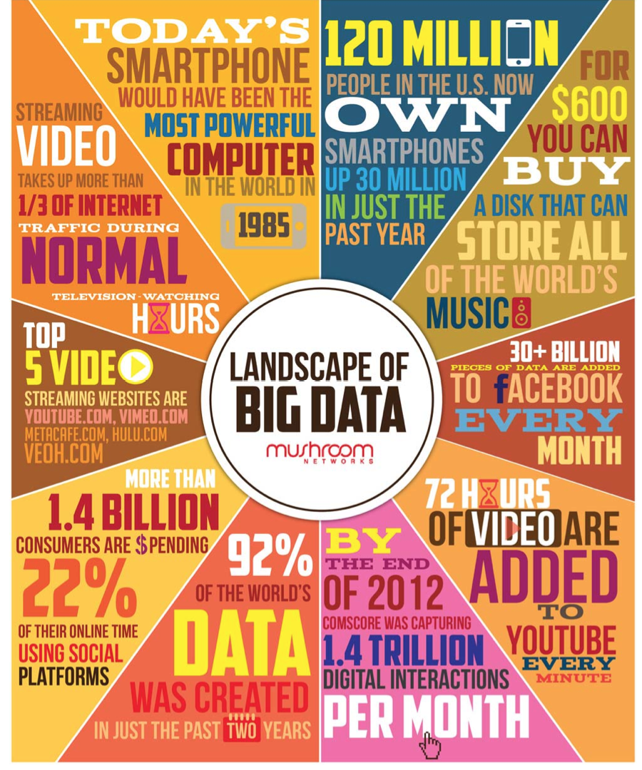
The Era of Big Data
Technological shifts, e.g., mobile devices, have created a staggering number of enormous data sets.
Both opportunities and challenges.

Slide 4
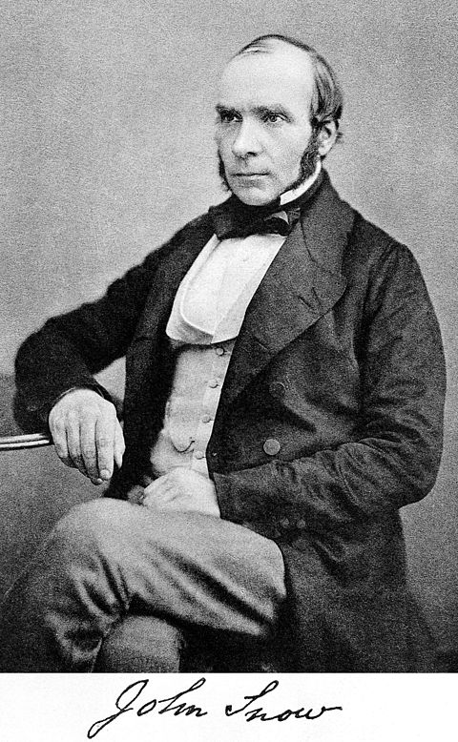

Opportunities are priceless!
The story of John Snow
“In the mid-1850s, Dr. John Snow plotted cholera deaths on a map, and in the corner of a particularly hard-hit buildings was a water pump. A 19th-century version of Big Data, which suggested an association between cholera and the water pump.”
Integrating data sets has saved millions of lives!

Slide 5
Opportunities are priceless!
“The systemic risks associated with the subprime lending market and the crash of the housing market in 2007 could have been modeled through a comprehensive integration and analysis of available public datasets. …. Integrating these datasets may have provided financial analysts, regulators and academic researchers, with comprehensive models to enable risk assessment.”
Proceedings of the International Workshop on Data Science for Macro-Modeling, 2013

Slide 6
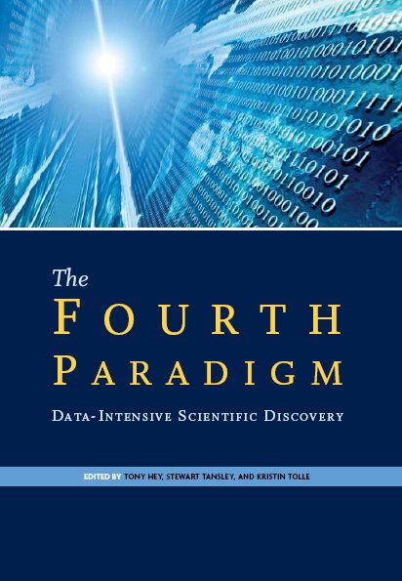
Paradigm shifting influence on scientific discovery
“The Fourth Paradigm: Data-Intensive Scientific Discovery”, Jim Gray
  Empirical
  Theoretical
  Computational
  Data-centric
Sloan Sky Server database is the most
highly cited resource in the field of astronomy.
  Astronomical observation => database query
Notes:
Spread of diseases by analyzing Google query log
Personalized medicine, drug discovery, …

Slide 7
Challenges: Volume
Sloan Sky Server will soon store 30 terabyte per day.
Hardon Colider can generate 500 exabyte per day.
Every two year : ten times more data
  Exponentially increasing:
    Smart/ wearable/ connected tools generate data
    Manufacturing tools generate data
    Humans generate data
    Robots generate data
    …

Slide 8
Challenges: Variety
Valuable information are scattered across various sources in various forms.
Large number of life databases and knowledge bases in every domain.
  Different modalities: images, videos, graphs/ social networks, natural language text documents/ posts, ….
Ideally, we like to integrate and store them in a single DB that can be queried and analyzed easily.
Need to transform, clean, and integrate large number
of evolving data sets.
  Impossible to do manually due to increasing number and varieties of datasets.

Slide 9
Challenges : Variety
It is arguably more challenging than volume, as it requires deeper understanding of the data
Data integration has been recognized as a hard problem in DB community.

Slide 10
Challenges : Velocity
Data is rapidly generated.
  smart devices, social networks, …
  fast data
Trends are changing in a short amount of time.
  News media, stock market, …
We like to get the insight fast.
Data may also evolve
  We do not like to rewrite our programs.

Slide 11
Challenges : Human collaboration
How users can communicate and use our systems?
  Not everybody has a degree in CS!
  Usable interfaces for users to query the data or build models Trends are changing in a short amount of time.
Users should understand the output
  Interpretability of the output
Collaborate with human
  How to harvest and integrate the intelligence of systems and human users?

Slide 12
Big Data Pipeline

Slide 13
Topics discussed in this course
Review data models and languages
  Relational data models
Graph data & Link analysis
Ranking over databases
Sampling over relational data
Learning over large databases
Parallel frameworks for data analysis
Big Data integration and cleaning
Human/ Data interaction and collaboration

Slide 14
Prerequisites
CS540 or equivalent
CS440 A- or above
Contact instructor if you are not sure.

Slide 15
Course format
Fundamental topics at the beginning.
Paper presentation and discussion.
One paper in most sessions.
Instructor or student presentation followed by group discussion led by the instructor and presenter.

Slide 16

Readings
Textbooks for reviewing basics:
  Foundations of databases, Serge Abitboul, Richard Hull, Victor Vianu (Alice book)
  Mining of massive datasets, Anand Rajarman and
  Jeff Ullman
  Research papers for the rest of materials: posted on the course website. http://classes.engr.oregonstate.edu/eecs/winter2019/cs519/schedule.html
  Useful links for background material will be also posted on the course website.

Slide 17
Discussion and participation
All students must read the paper and post a summary and questions on Piazza.
Each student should ask at least one question per week.
A short wrap-up quiz at the end of each presentation.
  Questions about the main concepts discussed.

Slide 18
Paper review
Read and summarize the papers before the lecture:
  What is the main problem discussed in the paper?
  Why is it important?
  What are the main ideas of the proposed solutions?
  Positive and negatives?
  (extra) How can one extend this work?
References on the course website on “how to read scientific papers”.
Post a 300-words summary of the paper on Piazza by 11:00 pm of the day before the class as private posts.

Slide 19
Student presentation
Instructor/ student collaboration to present.
A list of papers posted online
Multiple papers for some subjects
Choose a list of five exciting paper /subject for you by next Tuesday.
Email the presentation material by 5:00 pm four days before to get feedback.
It is ok to use presentations online
  acknowledge the authors.

Slide 20
Projects
Solve some interesting and challenging Big Data integration and cleaning problem.
Graded based on technical depth
  Work with large (millions of tuples/records) and diverse databases (5-10 datasets with different formats).
  The idea must generalize/ remove some manual effort.
Graded based on the clarity of presentation.
  Project reports and presentations
Groups of 2 – 4 students.

Slide 21
Projects: data integration
Information about an entity is in several sources
  Wikipedia, online posts, …
Integrate the data and resolve the inconsistencies
  transform data into a universal format
  integrate and clean the data
Mostly manual!
Reduce the amount of manual labor.
Integration in a specific domain is easier!
  certain data formats: e.g., online posts

Slide 22
Data integration
Step 1) Identify:
  Find a set of diverse data sets in terms of formats.
Step 2) Integrate:
  Transform and clean the data sets
  Integrate them in a relational database.
Step 3) Analyze:
  Run interesting queries and/or create visualizations

Slide 23
Data cleaning & transformation
Most data scientists spend about 80% of their times on data preparation!
  most data sets are in spreadsheets, flat files, XML, …
  transform/clean them to a a “desired representation”
    Removing meaningless values, apply constraints, …
  transform them to relational / RDF format

Slide 24
Data cleaning & transformation
Currently most data preparation are done manually.
  Reduce the manual cleaning/ restructuring burden
  Learning from examples
Predicative transformation
  Identify the most frequent/ likely transformations operations for a domain and generate them automatically.
More usable transformation interfaces

Slide 25
Project milestones
Project proposal: due on 4/16
  one-page summary
  group name and members
  what do you want to solve?
  which tools, data sets, systems you will use?
Midterm report and presentation: due on 5/7
  3-6 pages
  detailed description of the problem
  Your approach to solve it.
  Your progress, challenges, and your plan to solve them.
Presentation in class: 6/6
Final report: due on 6/7
  Description (5-10 pages) of your work and conclusion.

Slide 26
Projects: start early!
Form teams.
Evaluate possible topics for your project.
Discuss your ideas and progress with me.
Submit your project proposal.

Slide 27
How to get the most out of the course?
Communicate with the instructor
  Piazza
    preferred method of communication
  Office hours
    Arash: Thursday 11:20 – 12:20 pm, Kelley 3053
    Email me only if you cannot use Piazza
    Use [cs519] tag in the subject line.
Check the course website for schedule, administration information, or possible changes in the schedule. http://classes.engr.oregonstate.edu/eecs/spring2019/cs519-001
Check Piazza for announcements or possible changes in the schedule.

Slide 28
Grading Scheme
Paper review: 15%
Paper presentation: 20%
Discussion : 10%
Quiz: 15%
Project: 40%

