Slide 1
Wrangler: Interactive Visual Specification of Data Transformation Scripts
Sean Kandel , Andreas Paepcke , Joseph Hellerstein and Jeffrey Heer
Presented by You Jen Lin

Slide 2
Introduction
Before analysis, data must be “wrangled” into a usable form.
Data wrangling: restructure data, identifying and correcting erroneous/missing values, combining data sources.

Slide 3
Motivation
Data analysts still spend a lot of time wrangling data in preparation for analysis.
Transforms for restructuring/validating data can be complicated to specify in scripts.
e.g. Regular expressions to split strings, validate data format.
Reuse and revision of transforms for data updates and changing schemas not possible with scripts or manual editing.
Data wrangling should also output a record of transforms used.

Slide 4
Contributions
Underlying declarative transformation language based on Potter’s Wheel.
Supports six classes of transforms.
Interactive user interface that simplifies the way users can specify and apply transforms to data.
Natural language descriptions of transforms.
Visual previews of transform effects on data.
Interactive history viewer
Inference engine suggests applicable transforms based on user interaction with data.

Slide 5
Transformation language

Slide 6
General structure
Extension of Potter’s Wheel.
Added operators for data cleaning:
Positional operators
Aggregation
Reshaping
Added conditional mapping operators.
e.g. Update country to “U.S.” where state=“California”.

Slide 7
Classes of transforms
Eight classes of transforms.
Map: map one input data row to zero or more output rows.
Delete (1-to-0): Takes as predicate a row to remove.
Extract, cut, update (1-to-1): Process values within a column.
Split (1-to-many): Split text on some delimiter to yield multiple rows.

Slide 8
Classes of transforms (cont.)
Lookups and joins: lookup or join data from external tables.
Wrangler provides lookup tables for common transformations, e.g. mapping zip codes to states.
Equi-join: join on some attribute of two tuples from different tables if their values are the same.
Approximate join: join if the values of a common attribute of two tuples is within some string edit distance.

Slide 9
Classes of transforms (cont.)
Reshape: manipulate table structure and schema.
Fold: collapse multiple columns into fewer columns containing key-value sets rather than individual values.
Unfold: creates new column headers from data values that could be stored in multiple columns.

Slide 10
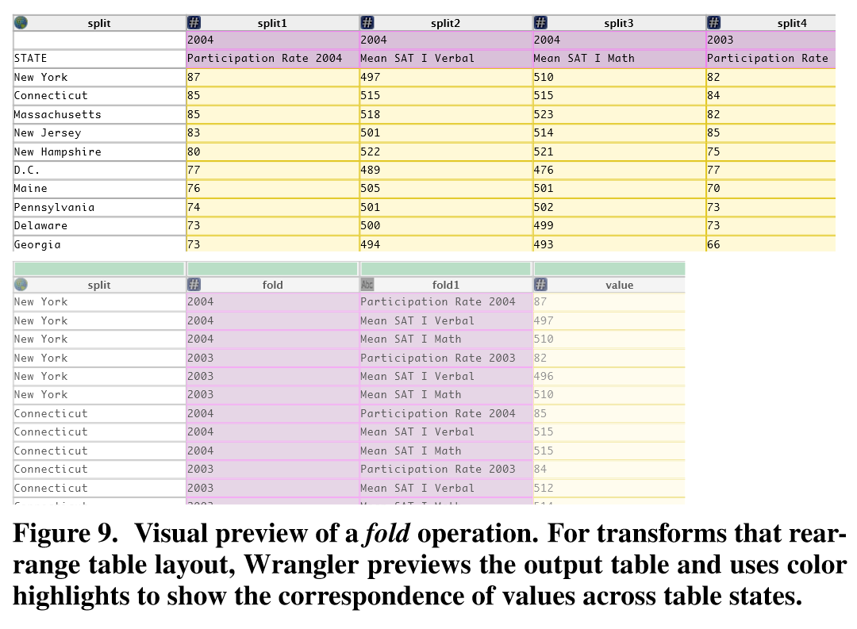
Fold transform

Slide 11
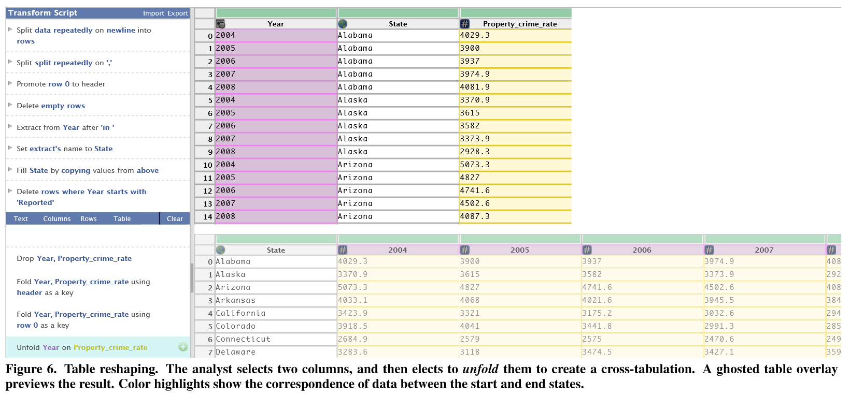
Unfold transform

Slide 12
Classes of transforms (cont.)
Positional: modifies the values or their position based on their location in the table.
Fill: generate values based on neighboring values.
Lag: shift column values up or down by a specified number of rows.
Sorting
Aggregation (sum, min, max, mean, etc.)
Key generation (skolemization): retrieval of keys for new records.
Schema transforms:
Set column name.
Specify column data type.
Assign semantic role.

Slide 13
Data types and semantic roles
Standard data types: primitives and their corresponding parsing functions.
Integers, strings, numeric.
Higher-level semantic roles: additional parsing functions, transformation functions mapping related roles, e.g.
Semantic role: zip code
Parsing function: check for 5 digits, valid
Mapping: return the state it is in

Slide 14
Interface design

Slide 15
Components
Direct manipulation of and interaction with the data.
Automatic suggestion of possible transforms.
Inference engine that bases suggestions of user input and data type/semantic role.
Menu-based transform selection.
Manual editing of transform parameters.

Slide 16
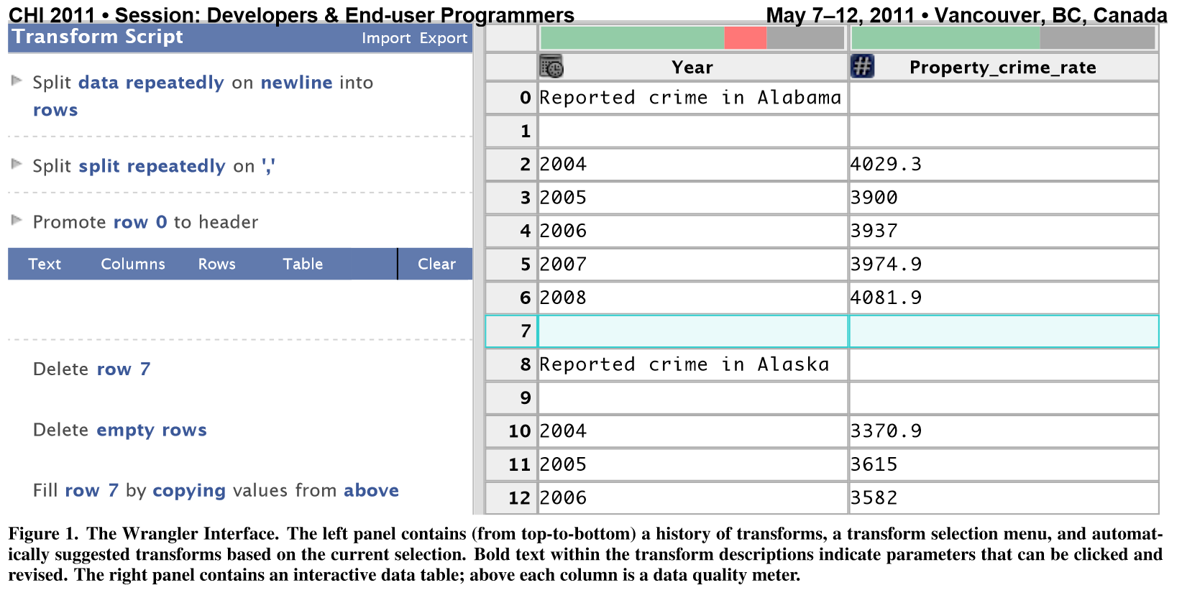
The Wrangler interface

Slide 17
Basic interactions
Wrangler supports six basic interactions between the user and the data table.
Select row.
Select column.
Click bars in the data quality meter.
Select text in a cell.
Edit a value in the table.
Assign column name, data type, or semantic role.

Slide 18
Additional interactions
Users can choose transforms from the menu to apply.
Users can also edit transform descriptions and their parameters to customize a transform.

Slide 19
Automated transform suggestion
Wrangler generates a list of suggested transforms while the user interacts with data.
Displays only a fraction of the entire suggestion space if there are many possible transforms.
Users can prune and reorder the suggestion shown:
Select more example data to disambiguate input.
Select an operator from the transform menu.
Edit a transform’s parameters.

Slide 20
Editing transforms
Wrangler does not immediately execute a selected transform.
Creates a current working transform.
Displays natural language description:
Transform type and parameters, both editable.
Non-critical defaults may be omitted.
Allows user to edit transform parameters and updates the suggestions as edits are made.

Slide 21
Visual previews
Shows users the effects of their transforms within the source data itself, not as a separate view (e.g. side-by-side before and after).
Five different preview classes.
Preview selected by Wrangler based on transform type.

Slide 22
Visual previews (cont.)
Selection preview: Highlights in yellow the regions of text that will be affected by the transform.
Deletion preview: Highlights in red the cells to be deleted.
Update preview: Overwrites values with their new values and highlights them in yellow.

Slide 23
Visual previews (cont.)
Column preview: displays newly-derived columns and highlights them in yellow.
Table preview: for fold and unfold, shows the new table side-by-side with the old since these transforms modify the table too much

Slide 24
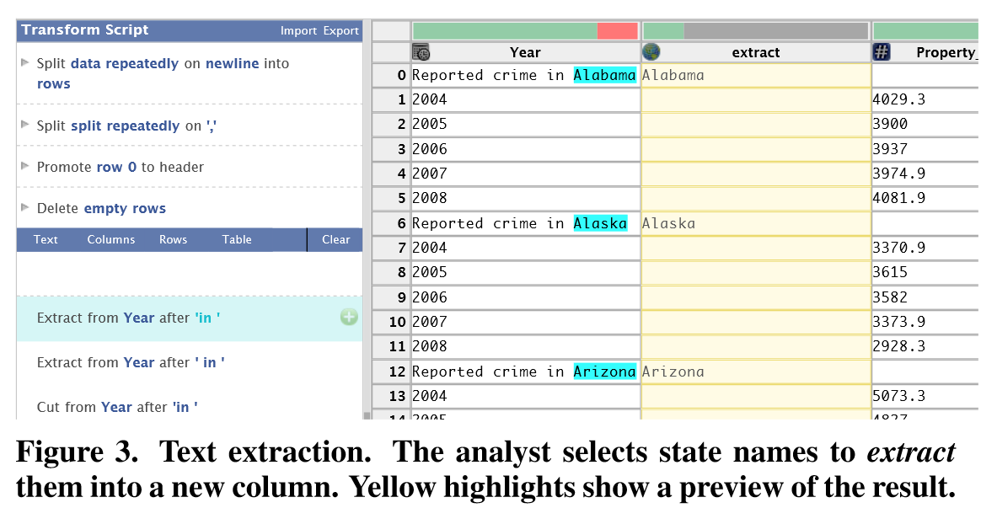
Example of selection preview

Slide 25
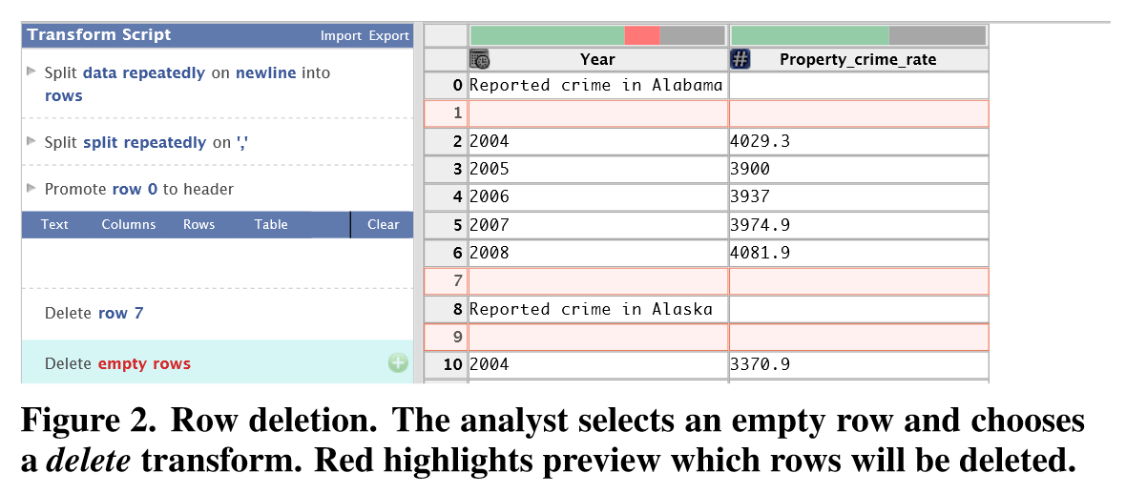
Example of deletion preview

Slide 26
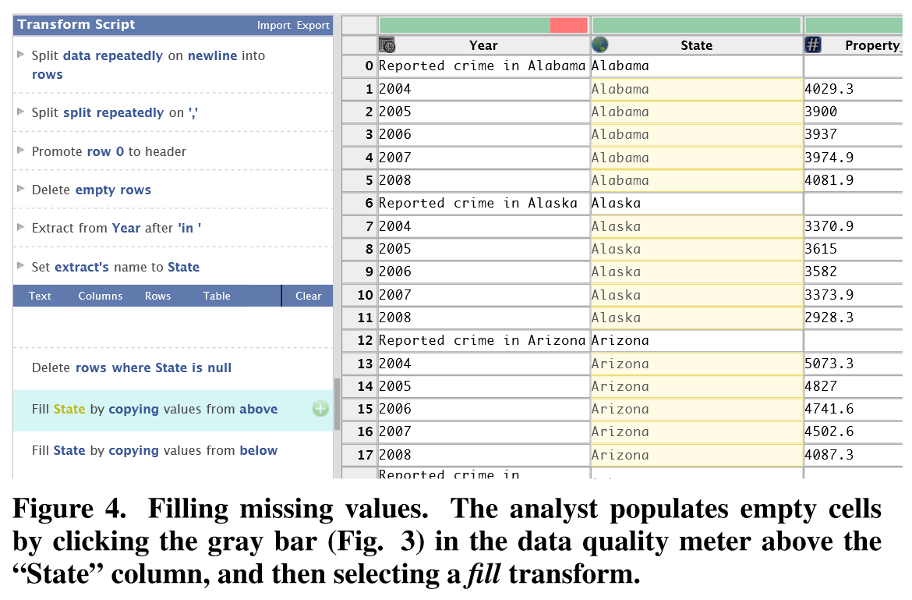
Example of update preview

Slide 27
Example of column preview

Slide 28
Example of table preview

Slide 29
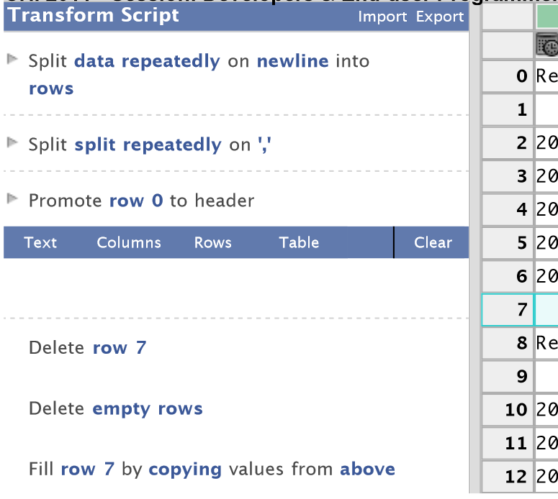
Transform history
Allows users to edit individual transform descriptions and enable/disable transforms in the sequence.
Allows text annotations for analysts to document why they used a particular transform.

Slide 30
Data quality
Wrangler applies validation functions to a sample of a column’s data to determine the proportion of values that parse successfully.
Data quality meter:
Green: values that parse successfully.
Yellow: values match type, but not role.
e.g. Six-digit zip code in numeric, but not a zip code.
Red: values don’t match type.
Grey: values missing.

Slide 31
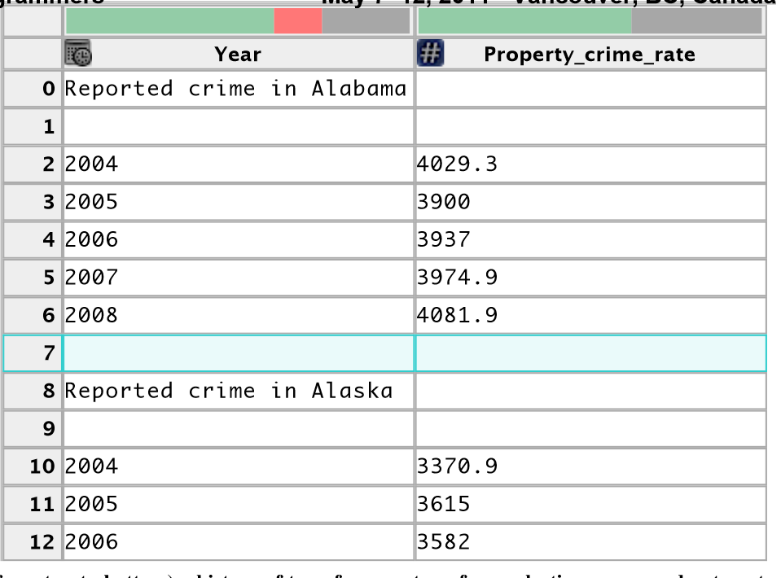
Data quality bar

Slide 32
Inference engine

Slide 33
Transform suggestions
Inference engine generates a ranked list of suggested transforms.
Input:
user interactions
current working transform
data descriptions
corpus of user’s transform usage history

Slide 34
Suggestion process
Three phases:
Infer transform parameters from interactions.
Generate candidate transforms from inferred parameters.
Rank the resulting transform suggestions.

Slide 35
Usage corpus
Contains frequency counts of transform descriptors and initiating interactions.
Original corpus built by authors from wrangling their own data sets.
Updates as analysts use it.
Generate transform frequencies via a relaxed matching routine.

Slide 36
Usage corpus
Transforms equivalent if:
Identical transform type, e.g. extract, fold, etc.
Equivalent parameters.
Four basic parameter types and equivalence:
Row: both contain filtering conditions or match all rows in a table.
Column: same data type/semantic role
Text selection: both index-based or contain regex.
Enumerables: exact match

Slide 37
Inferring parameter sets
Infer a parameter independent of others.
Row selection: row indices and predicate matching.
Column selection: the columns that the user has interacted with.
Text selection: index ranges or inferred regex.
Notes:
Text selection: extract selected text and any surrounding text within a 5-token window.
37

Slide 38
Suggested transforms
Loop over each transform type.
Emit types that can accept all parameters in the inferred parameter set.
Instantiate each transform with parameters from the set.
Filter suggestions to exclude degenerate transforms (no effect on data).

Slide 39
Ranking suggestions
Five criteria:
Three by transform type:
Explicit interactions: user chooses from menu or selects a current working transform.
Specification difficulty: row and text selection predicates are harder to specify than others; sort types by number of hard parameters each accepts.
Corpus frequency: also conditioned on their initiating user interaction.

Slide 40
Ranking suggestions (cont.)
Five criteria (cont.):
Two within transform type:
Frequency of equivalent transforms in the corpus.
Ascending order by transform complexity:
Rank simpler transforms higher since users can evaluate their descriptions more quickly.
Transform complexity: sum of parameter complexities.
Filter transforms so one type is <1/3 of the suggestions.
Notes:
Row selection predicate: complexity=(number of clauses).
Regex: complexity=(number of tokens)
Else 0.
40

Slide 41
Evaluation
Comparative user study with MS Excel.
Twelve participants, all of whom have never used Wrangler and with varying degrees of experience with Excel.
Three tasks: extract text, fill missing values, reshape table structure.
Result: Median performance in Wrangler was >2x as fast as in Excel for all experience levels.

Slide 42
Conclusion
Wrangler: interactive interface for data transformation and cleaning.
Maps user interactions to suggested transforms.
Editable transform history.
In-place transform previews.

